Slide 1
*note:
Reading Application Partner
Make your cursor
Energy level – time to replenish the energy points.

Slide 2

RAP
Reading Application Partner

Slide 3

START READ
MENU
EXIT

Slide 4

Levels
01
03
05
02
04
06
BACK

Slide 5


Level 01
Short vowel sound
Day 1
Day 2
Day 3
Day 4
Day 5
RETURN

Slide 6

BACK
Day 1
Let’s PLAY

Slide 7
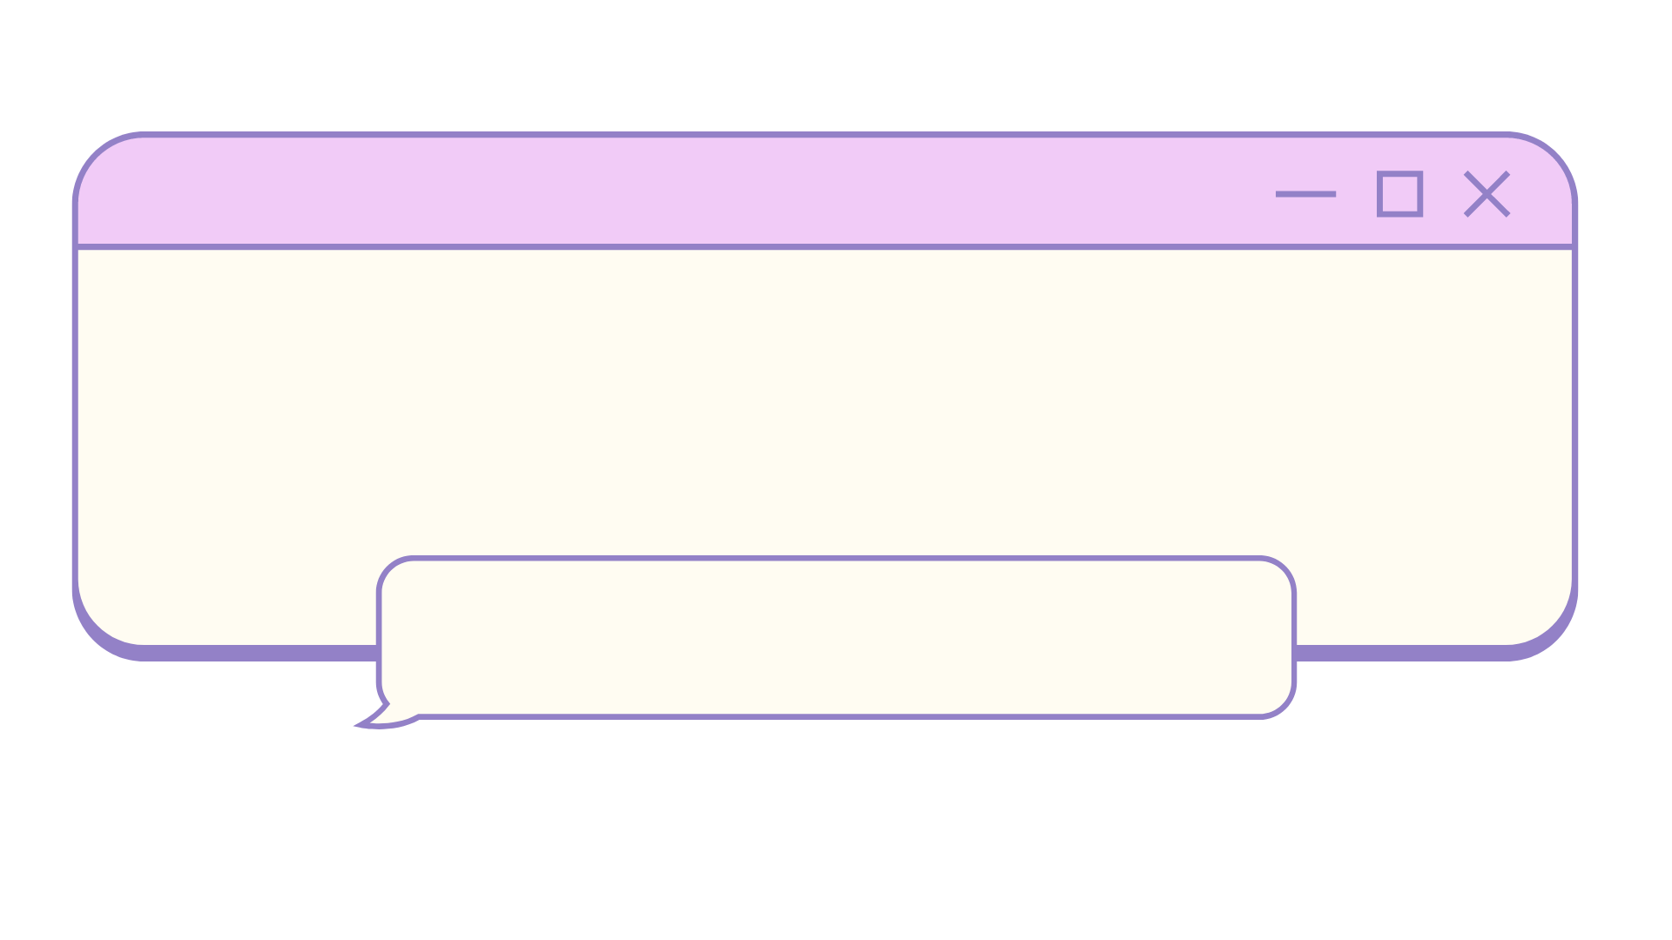

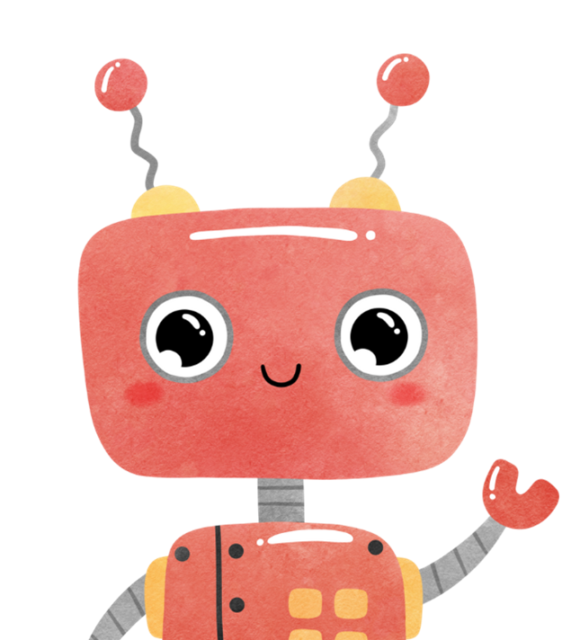
Directions:
Say the name of each picture. Then, check the picture that has the short vowel sound given above.
Are you ready to play?

Slide 8


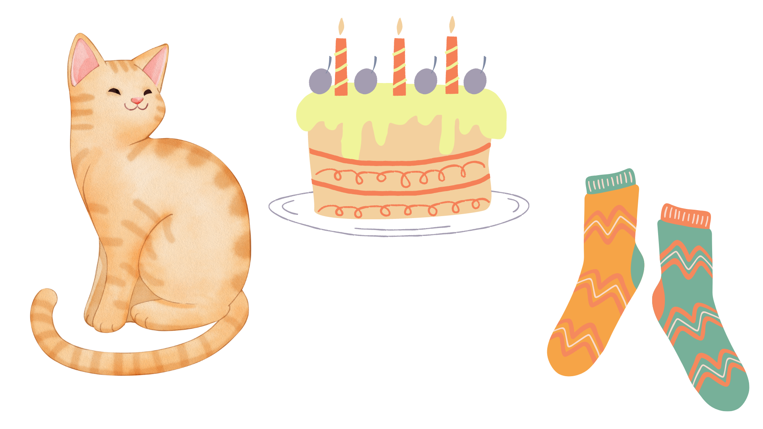
Which of these picture has the
short “a sound”

Slide 9
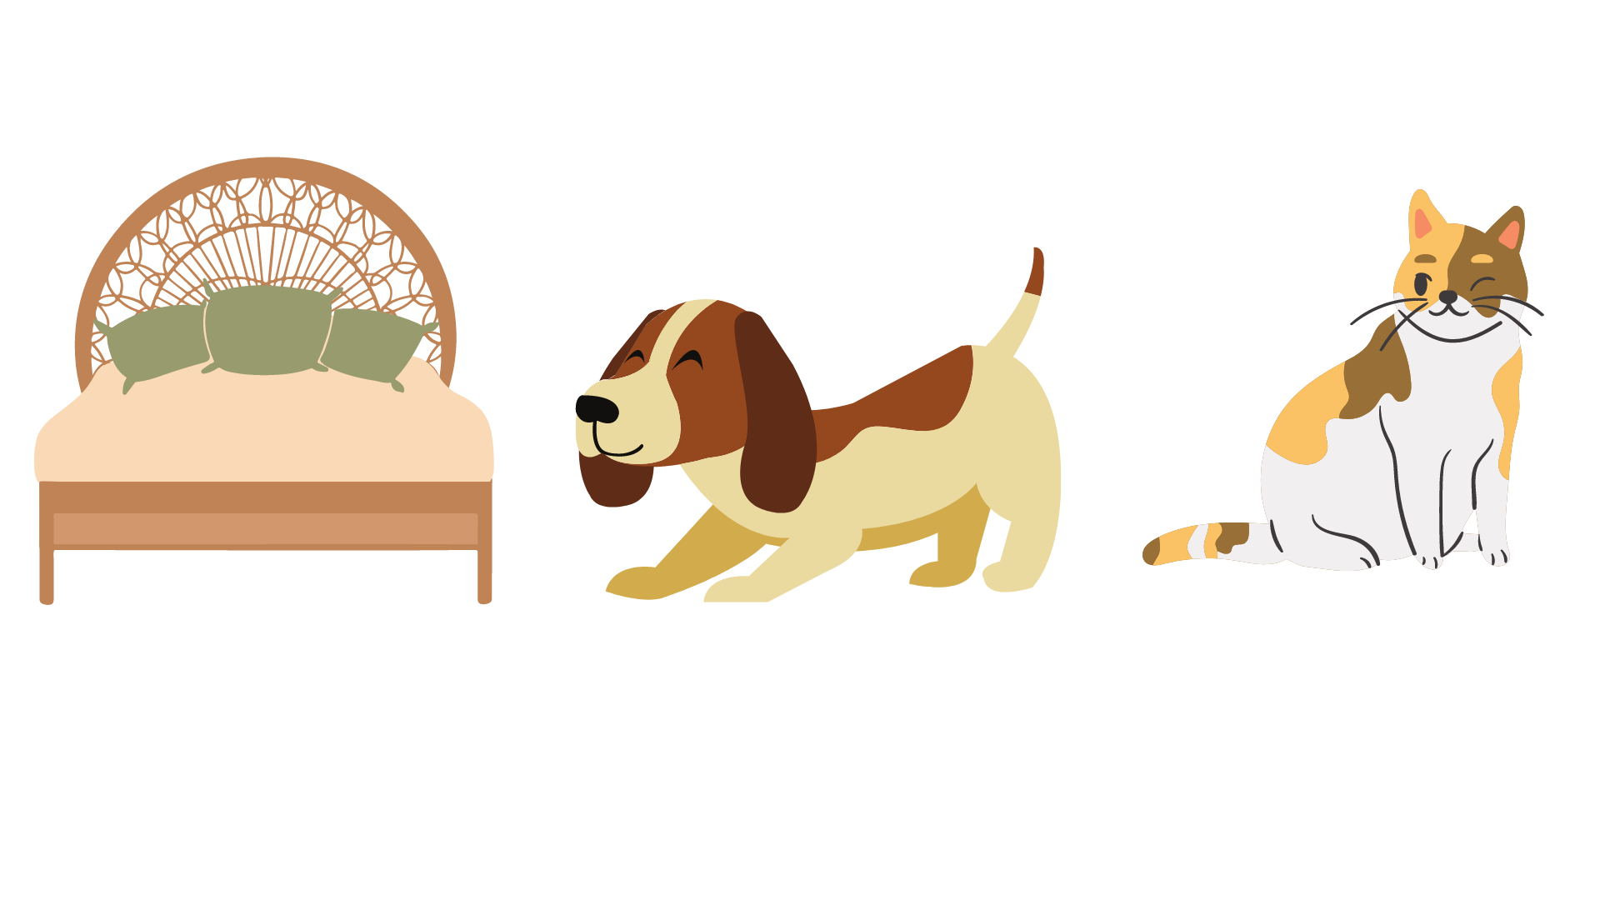
Which of these picture has the
short “e sound”

Slide 10
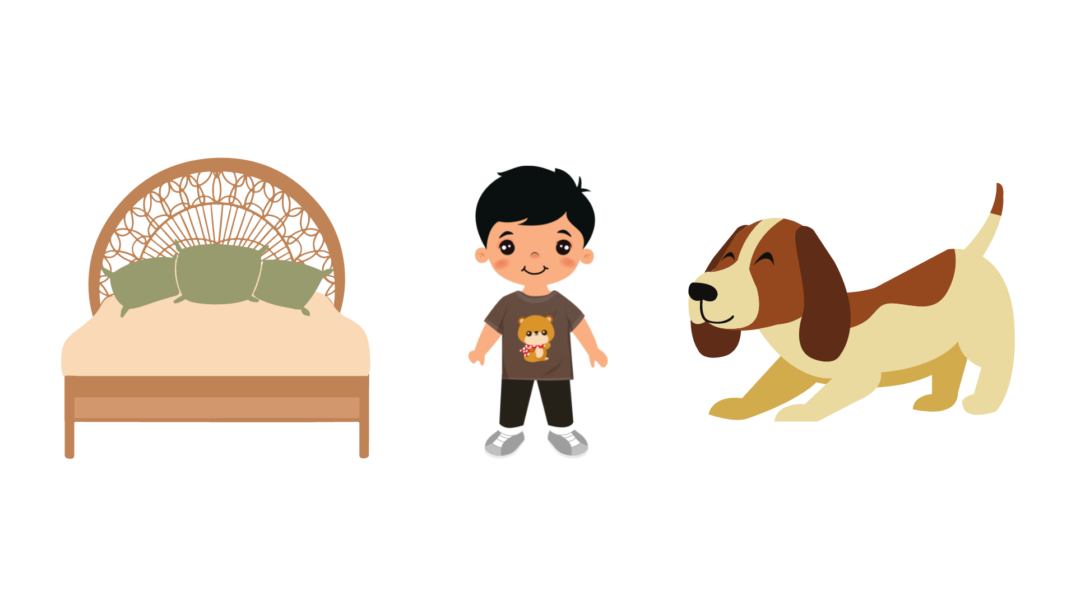
Which of these picture has the
short “i sound”

Slide 11
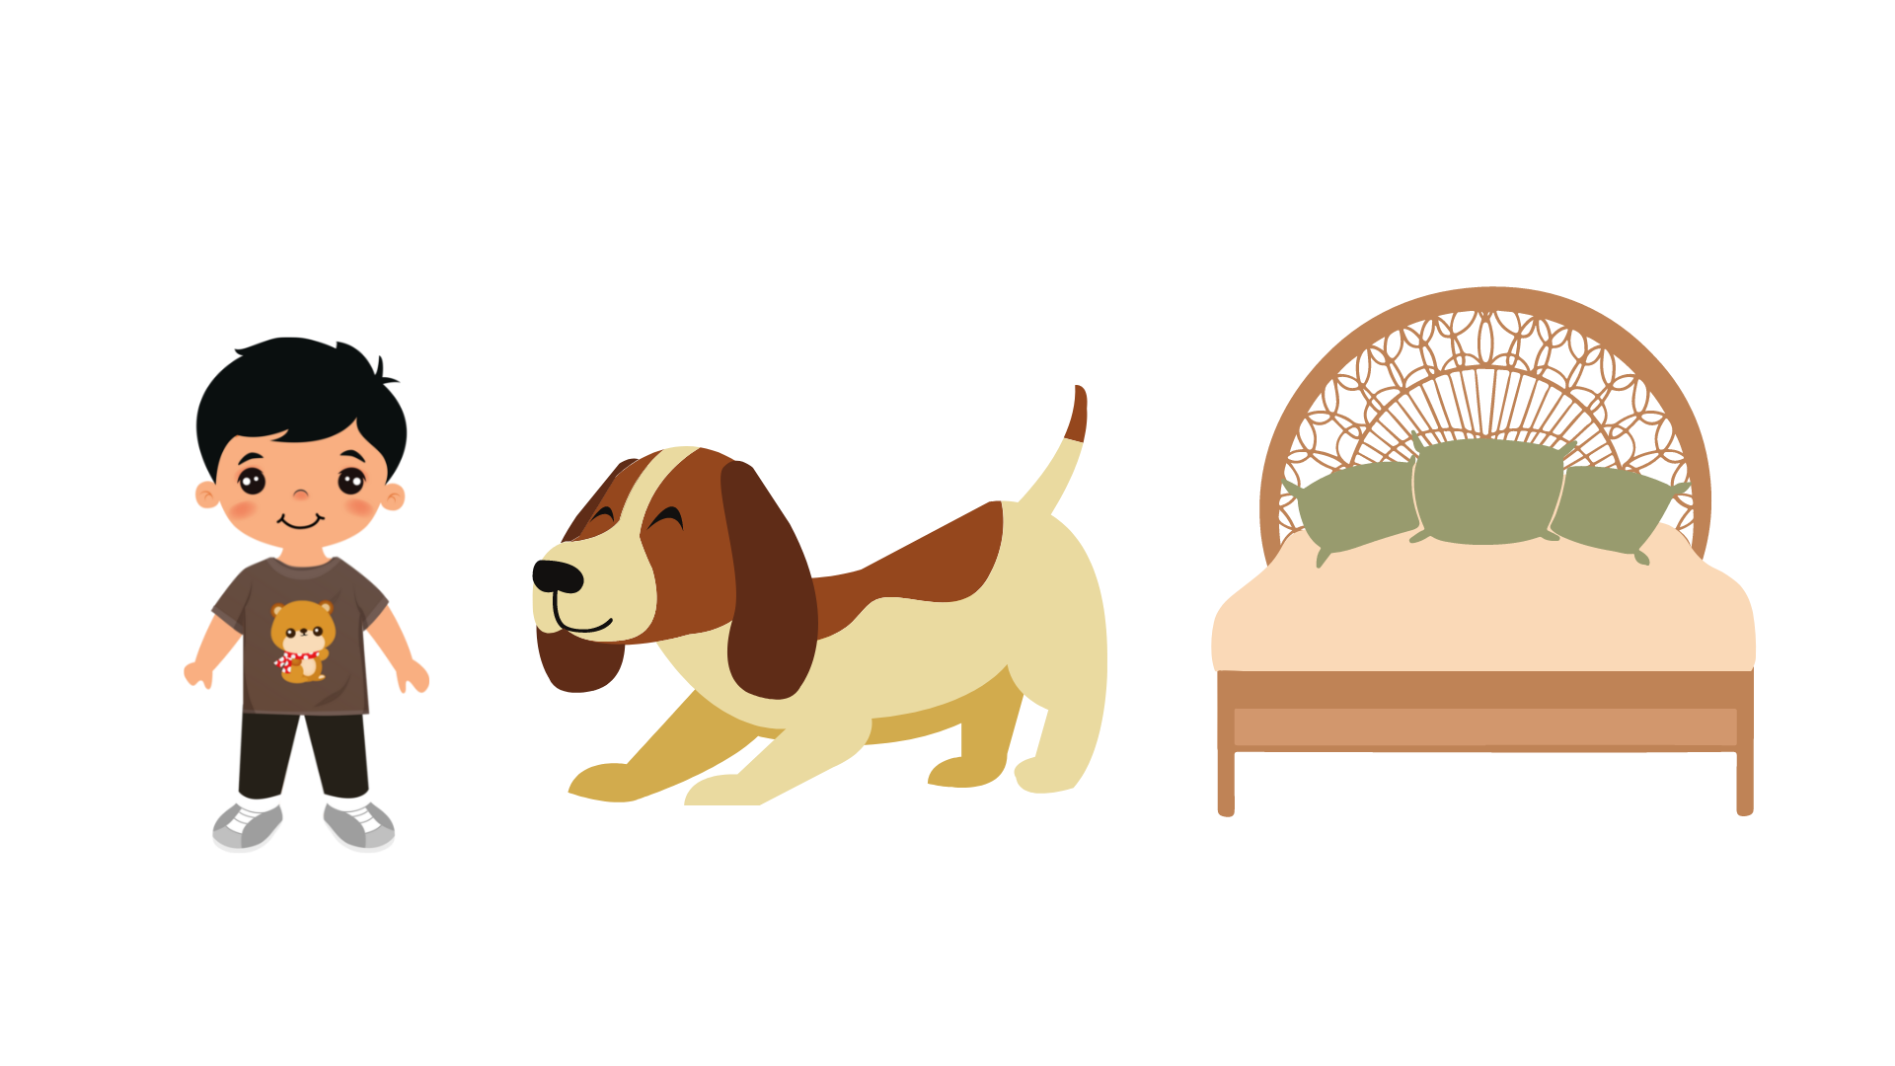
Which of these picture has the
short “o sound”

Slide 12
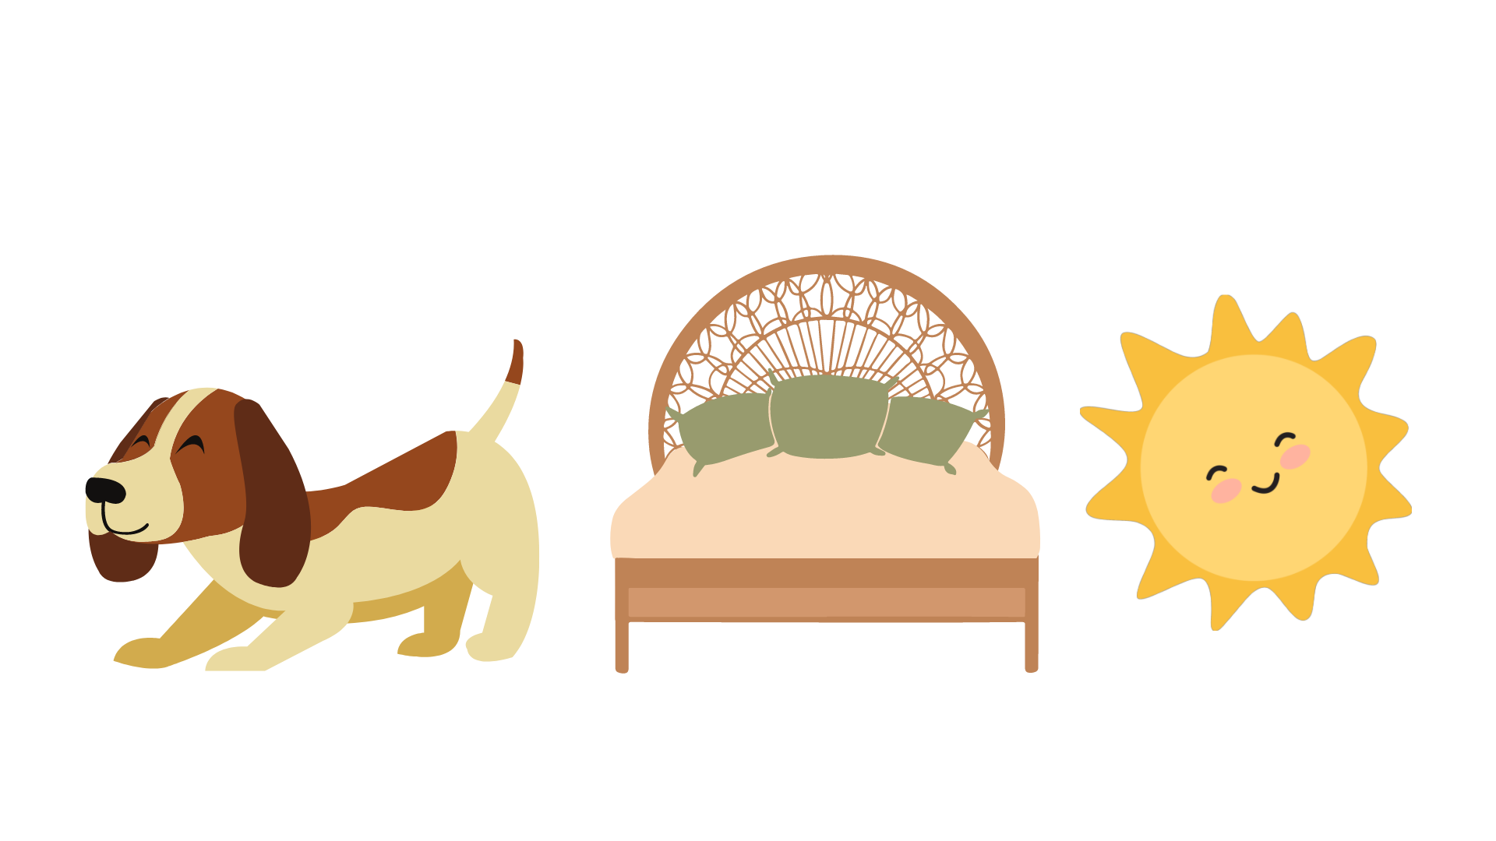
Which of these picture has the
short “u sound”

Slide 13
BACK
Day 2
I’m ready to READ some words.

Slide 14
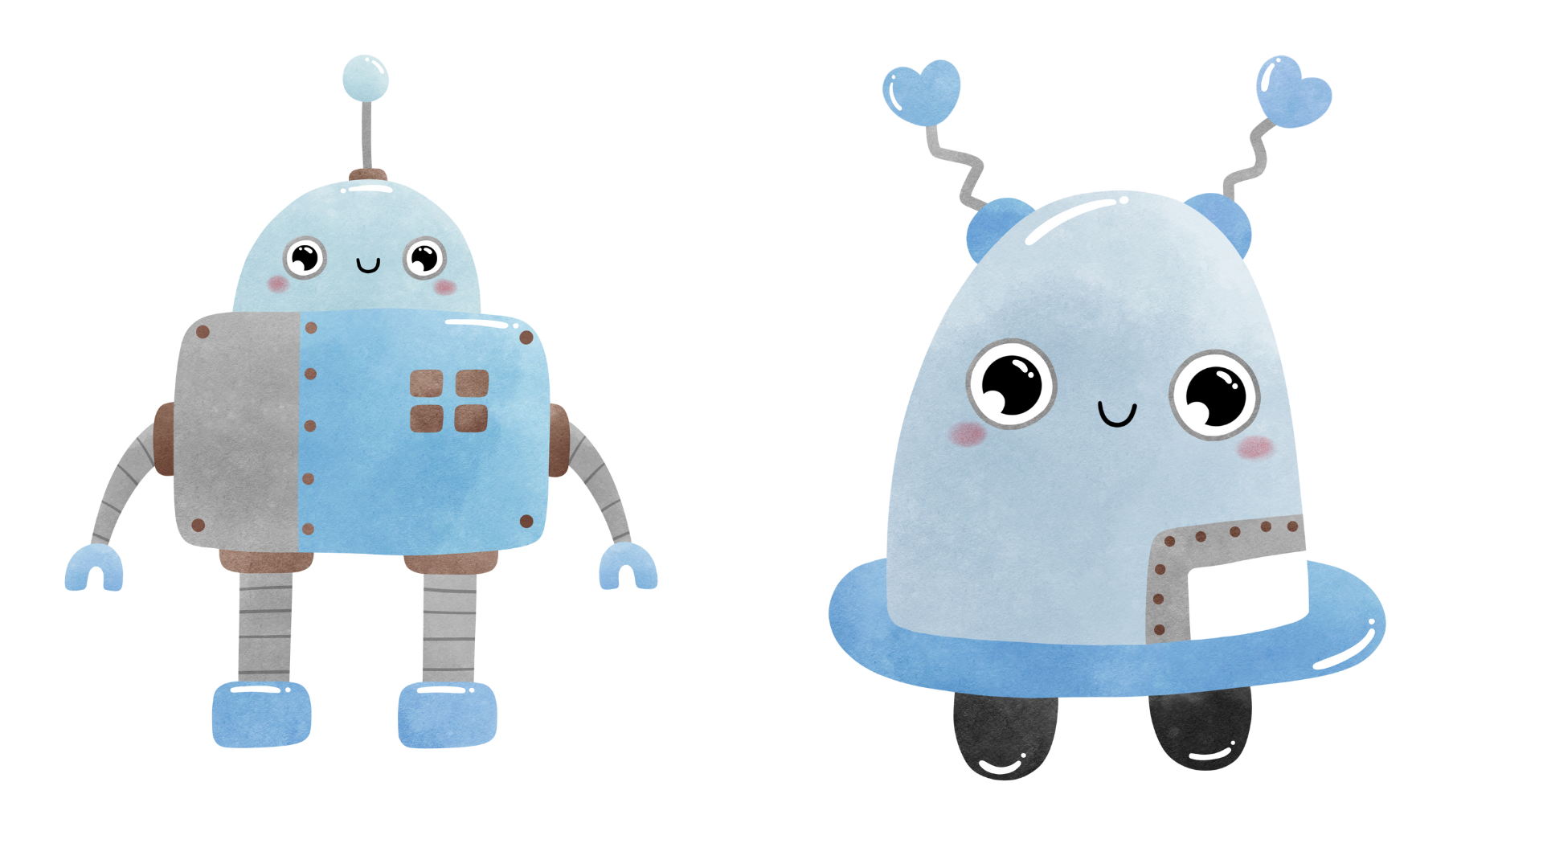
Reading Time!
: a sound or combination of sounds that has meaning and is spoken by a human being.
Words

Slide 15

Words with short a sound
Let’s read the following words with the short a sounds.
rat
cat
fat
mat
sat
man
van
can
tan
fan
bad
dad
had
mad
sad
bag
hag
rag
tag
wag
cap
tap
nap
lap
map

Slide 16
Words with short e sound
Let’s read the following words with the short e sound.
bed
red
Ted
wed
fed
ben
hen
pen
men
ten
pet
let
set
met
get
beg
keg
leg
peg
web
yes
hem
gem
yes

Slide 17
Words with short i sound
Let’s read the following words with the short i sound.
bin
sin
win
tin
pin
big
dig
wig
pig
fig
bit
hit
fit
sit
kit
dip
hip
rip
sip
tip
fix
mix
six
dim
rim

Slide 18
Words with short o sound
Let’s read the following words with the short o sound.
dog
jog
log
jog
fog
cop
mop
hop
pop
top
not
cot
lot
pot
rot
sob
rob
cob
mob
job
rod
mom
box
fox
pox

Slide 19
Words with short u sound
Let’s read the following words with the short u sound.
dug
jug
mug
rug
tug
but
cut
hut
nut
rut
bun
fun
gun
run
sun
cub
hub
rub
sub
tub
cup
pup
bus
bum
gum

Slide 20
BACK
Day 3
I’m ready to read Phrases and Sentences!

Slide 21
Reading Time!
: a group of two or more words that express a single idea but do not form a complete sentence
Phrases

Slide 22

Phrases:
mom and dad
the pet shop
a cat
big fat cat
pet shop man

Slide 23
Phrases:
in the backyard
the dog
Ted’s lap
took a nap
his head

Slide 24
Reading Time!
: an independent clause, with a subject and a predicate.
Sentences

Slide 25
Sentences:
1. Mom and dad take Ted and Sam to the pet shop.
2. They see a cat.
3. It is a big fat cat.
4. There’s a man in the pet shop.
5. Ted and Sam run into the backyard.

Slide 26
Sentences:
6. The dog is in the backyard.
7. The dog named Ben.
8. Dad put Ben on Ted’s lap.
9. Ben took a nap.
10. He pat his head.

Slide 27
BACK
Day 4
I’m ready to read a short story!

Slide 28

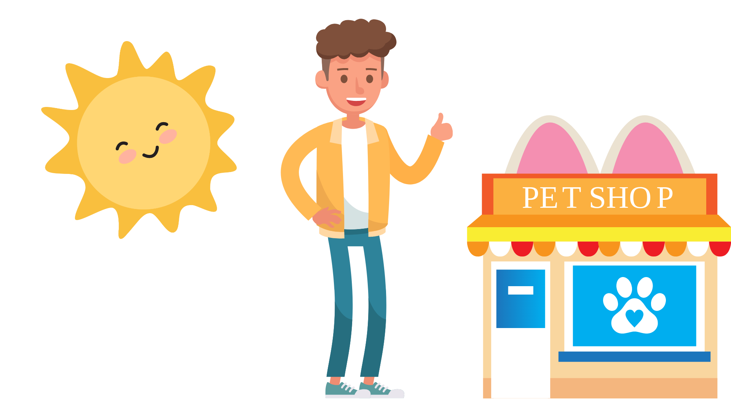

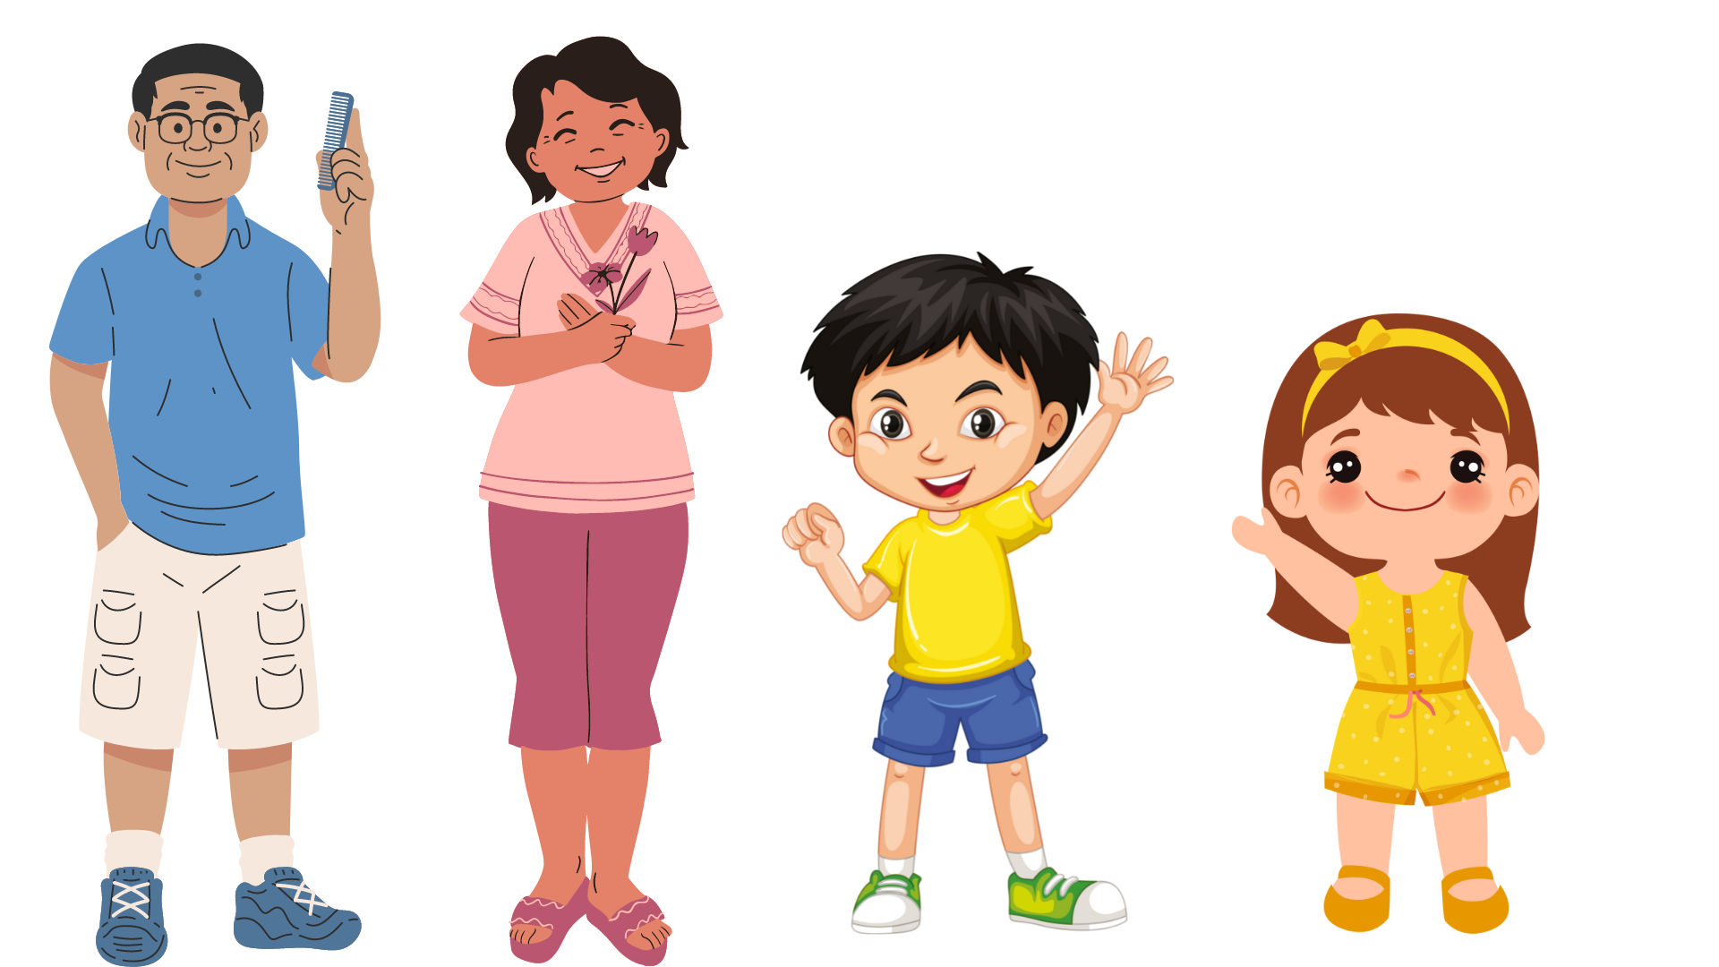
“MY PET”

Slide 29
One sunny day, dad and mom take Ted and Sam to the pet shop.

Slide 30
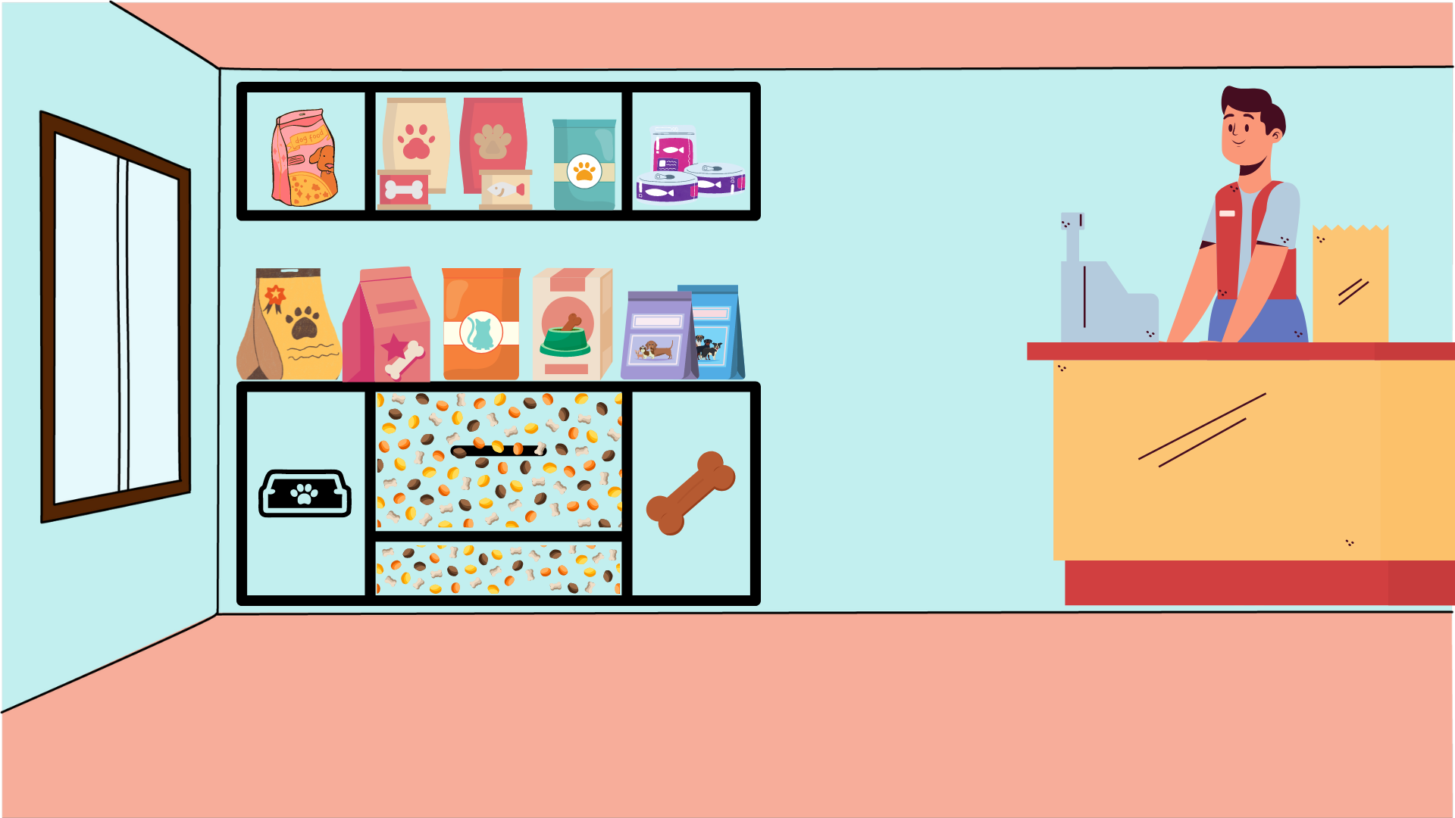
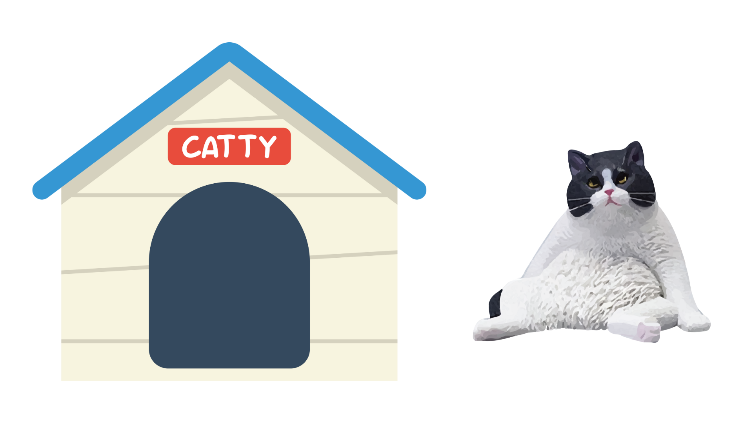
Ted and Sam see a cat in the pet shop.
It is a big fat cat.
The pet shop man said, “We also have dogs in the backyard”. Ted and Sam run into the backyard to look at the dogs.

Slide 31
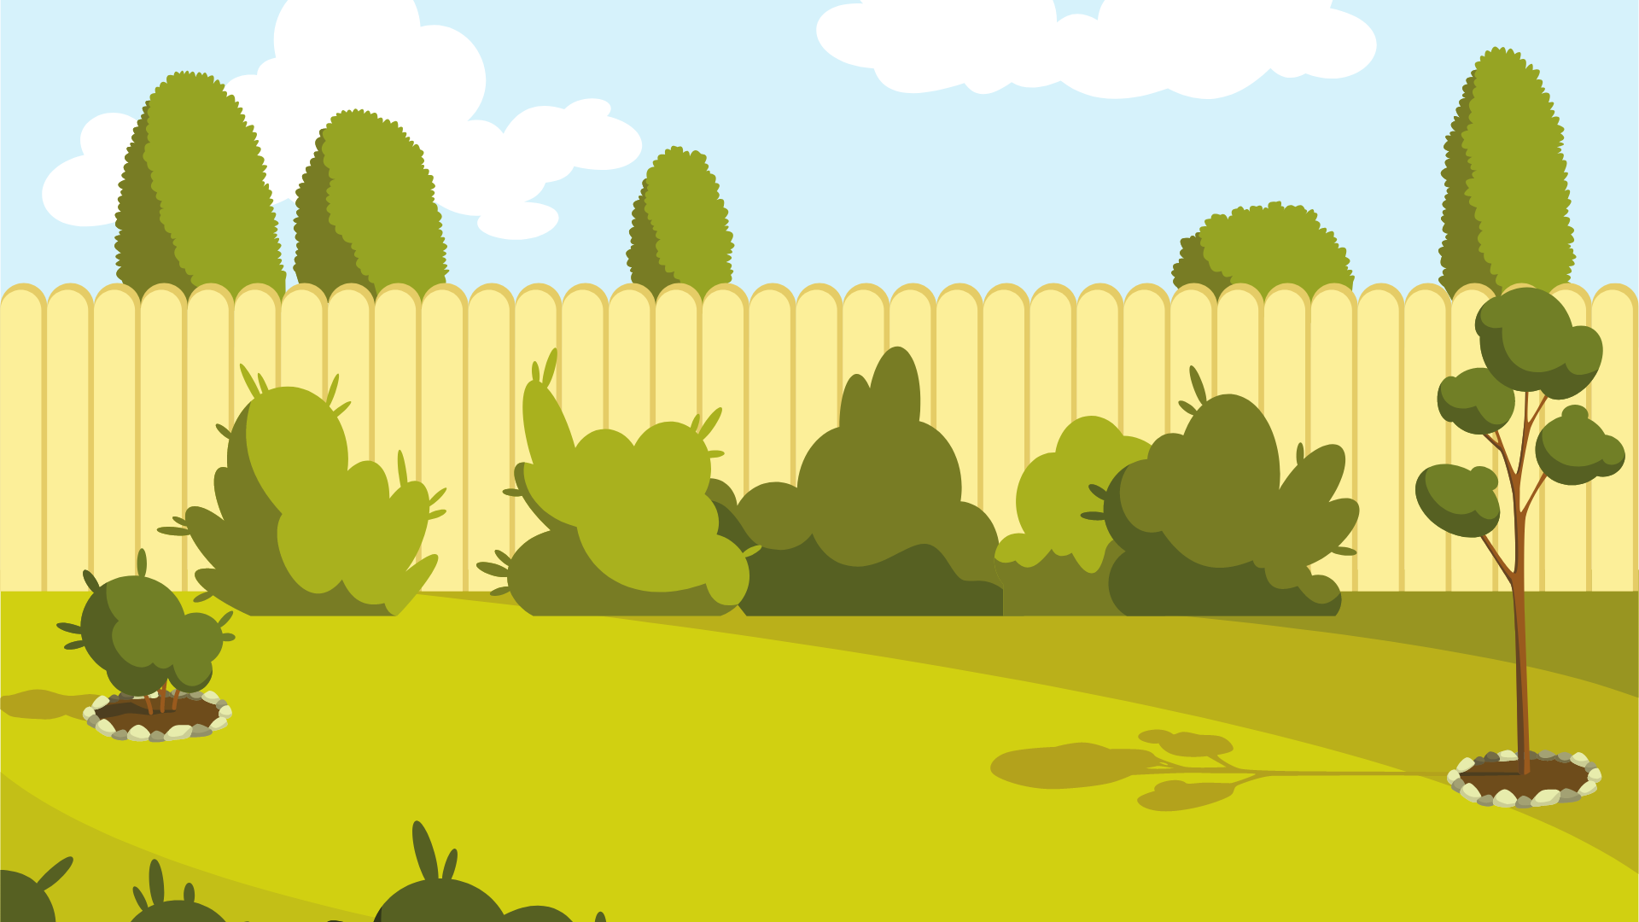
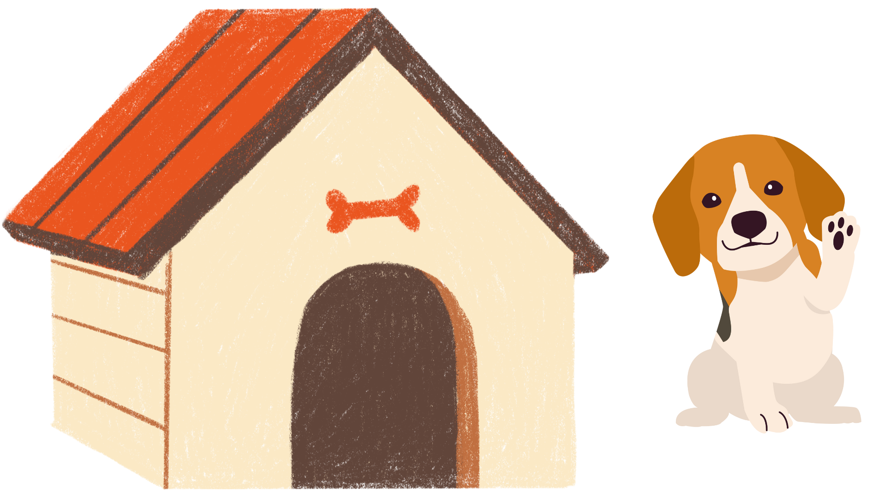
The dog yap. And his name is Ben. Dad put Ben on Ted’s lap. Ben took a nap.
Mom and dad ask the kids to pick a pet.
Ted and Sam pick Ben the dog. And then, Ted pats the head of his new dog.

Slide 32
BACK
Day 5
TEST ME!

Slide 33
Directions:
Read and understand each questions. Then, Click the correct answer.
Are you ready? Let’s begin…

Slide 34
Questions:
Who went to the pet shop?
Man
Mom, Dad, Ted and Sam
Ana

Slide 35
Questions:
The cat they saw is _____.
thin
fat
fluffy

Slide 36
Questions:
Who run into the backyard?
mom and dad
Ted and Sam
cat and dog

Slide 37
Questions:
What is the name of the dog?
Ben
Ted
Sam

Slide 38
Questions:
What kind of pet did Ted and Sam chose?
a cat
a rat
a dog

Slide 39
Level 02
Long vowel sound (ee, ea ,oa , and ow)
Day 1
Day 2
Day 3
Day 4
Day 5
RETURN

Slide 40
BACK
Day 1
Let’s PLAY

Slide 41
Directions:
What word names the picture? Draw a line from the word to the picture.
Are you ready to play?

Slide 42
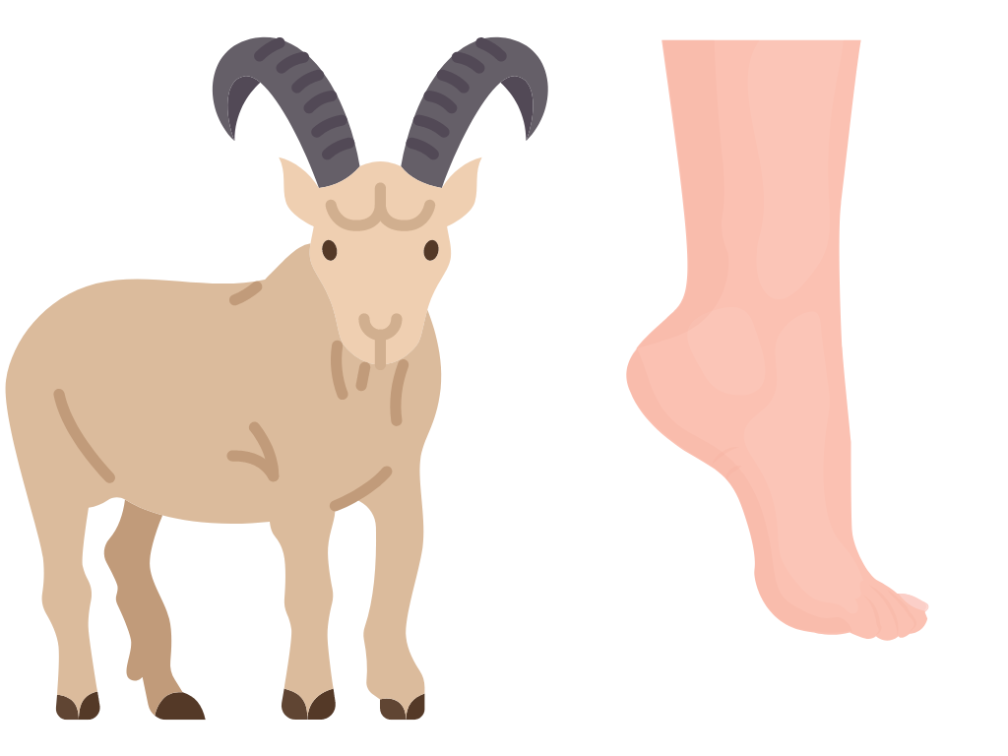
groan
goat
green
grow

Slide 43
heat
head
heel
heavy

Slide 44

tea
teeth
treat
tree

Slide 45

beach
bread
boat
bowl

Slide 46

seek
seat
sneak
snow

Slide 47
BACK
Day 2
I’m ready to READ some words.

Slide 48
Reading Time!
: Vowel digraphs are two vowels that when placed together generate one sound.
Vowel Diagraphs

Slide 49

Here are some examples of vowel digraphs

Slide 50
Words with long ee sound
Let’s read the following words with the long ee sounds.
see
tee
bee
eel
deed
feed
seed
weed
need
beef
reef
week
seek
leek
peek
feel
heel
jeep
deep
keep
beep
cheek
teeth
queen

Slide 51
Words with long ea sound
Let’s read the following words with the long ea sounds.
eat
sea
tea
meat
seat
beak
weak
peak
leak
team
bean
meal
heat
beach
jeans
bead
eagle
peach
tear
neat
clean
leaf
seal
beat
read

Slide 52
Words with long oa sound
Let’s read the following words with the long oa sounds.
boat
coat
goat
goal
foam
roam
loan
loaf
soap
load
float
road
coal
throat
toast

Slide 53
Words with long ow sound
Let’s read the following words with the long ow sounds.
low
row
bow
tow
glow
snow
know
show
slow
grow
arrow
below
fellow
hollow
pillow
follow
window
yellow
flow

Slide 54
BACK
Day 3
Let’s Practice!

Slide 55
Practice Time!
Click the pictures with long vowel sound (ee, ea ,oa , and ow)
Are you ready?

Slide 56

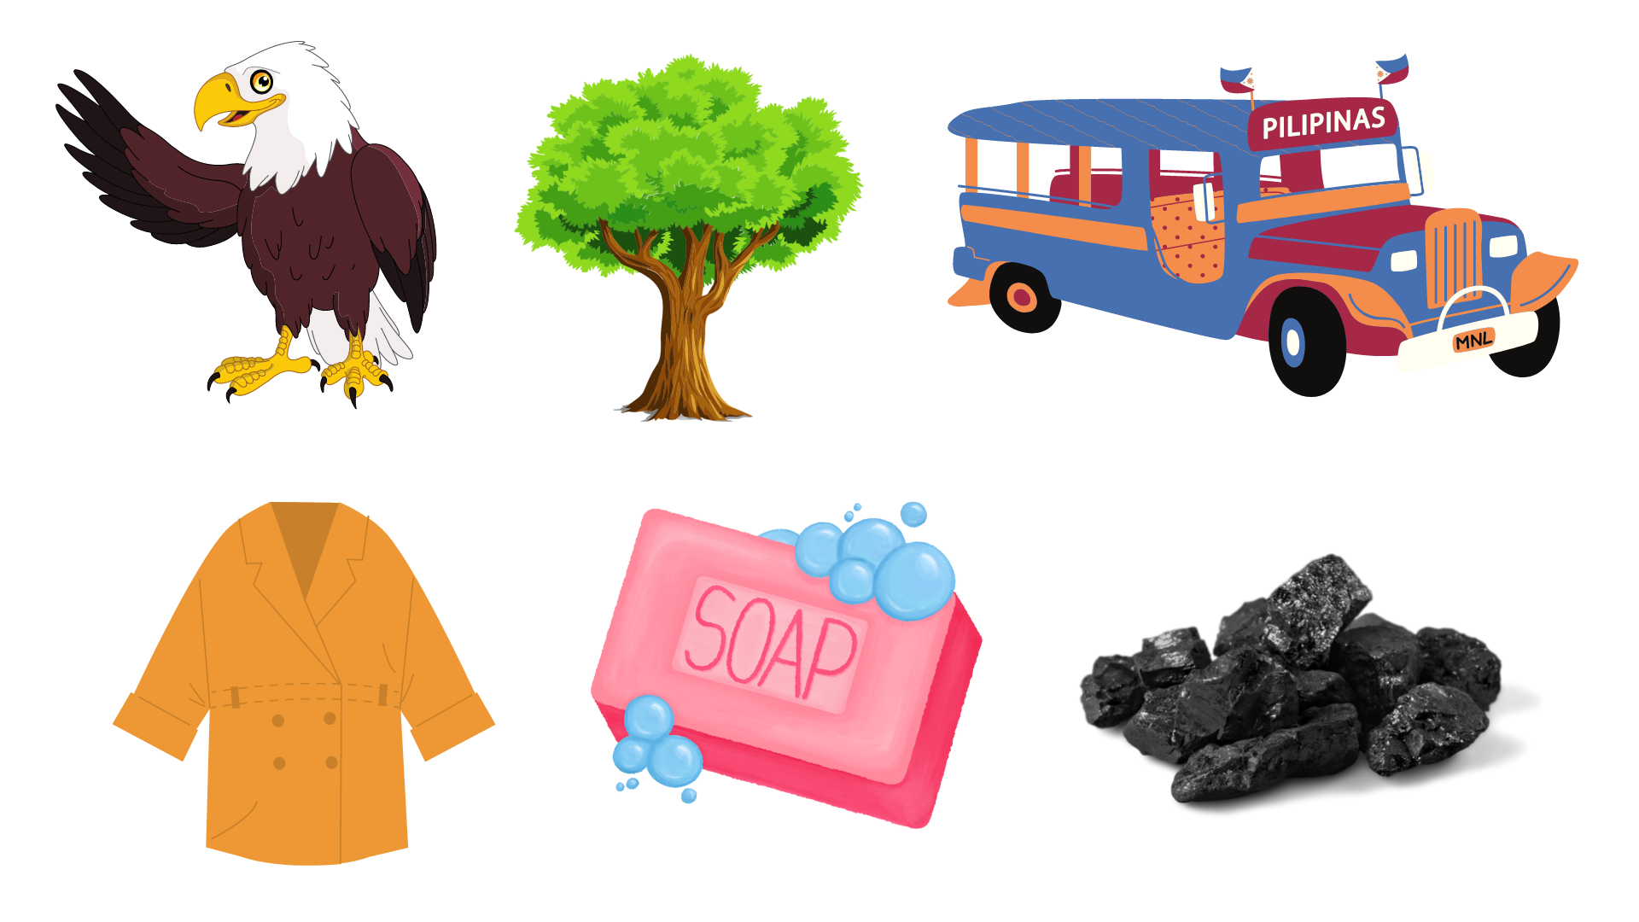
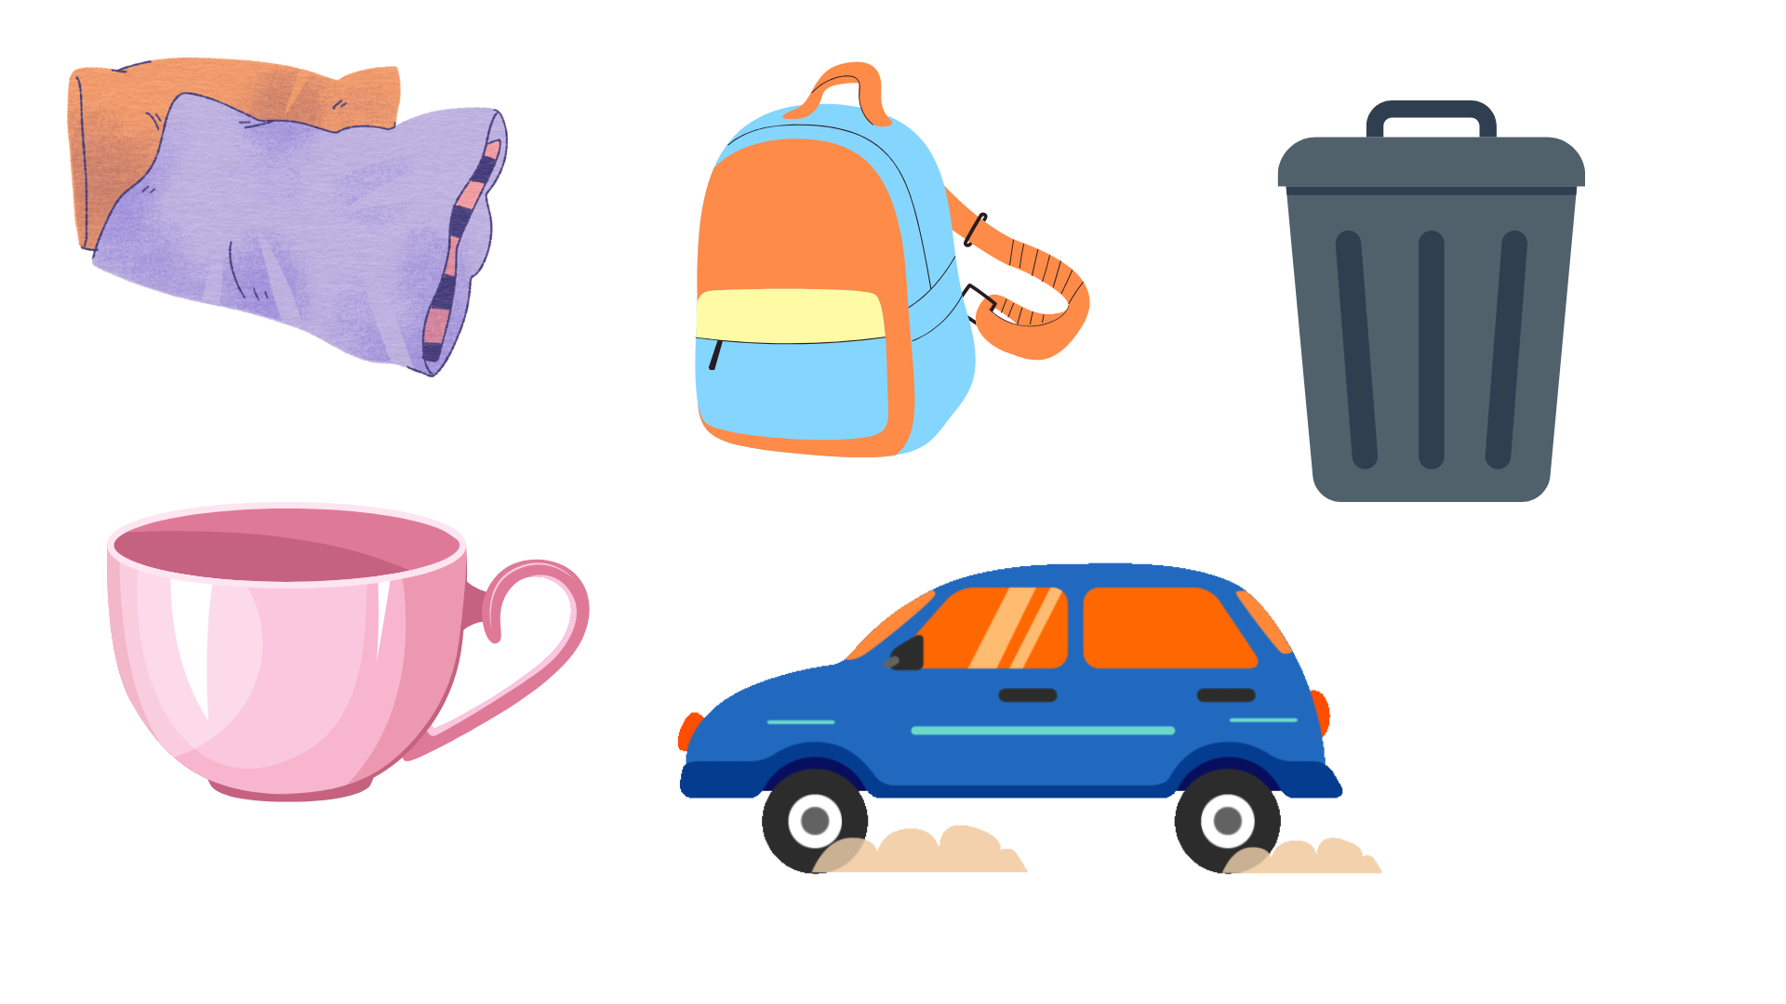
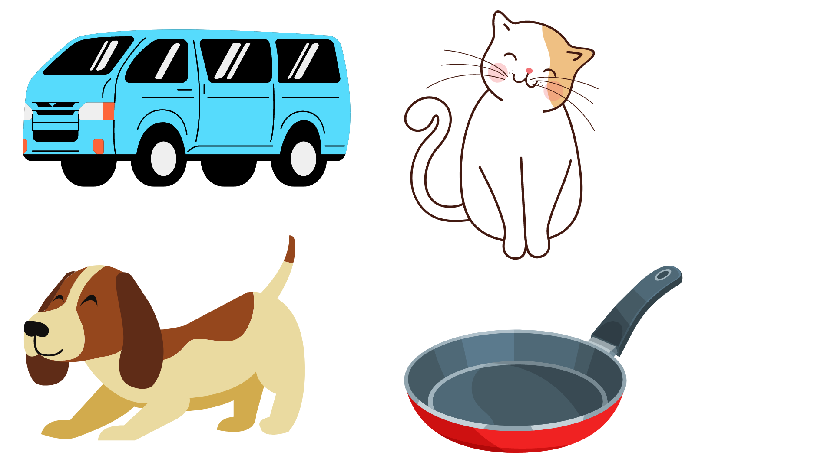

Slide 59
Practice Time!
Click the words with long vowel sound (ee, ea ,oa , and ow)
Are you ready?

Slide 60


see
beach
fat
bad
glow
cup
show
rain
boat

Slide 61
arrow
foam
moon
read
glow
gem
car
team
bead

Slide 62
flag
bellow
dress
sea
meat
road
coal
crab
blue

Slide 63


Slide 64
BACK
Day 4
I’m ready to read a short story!

Slide 65
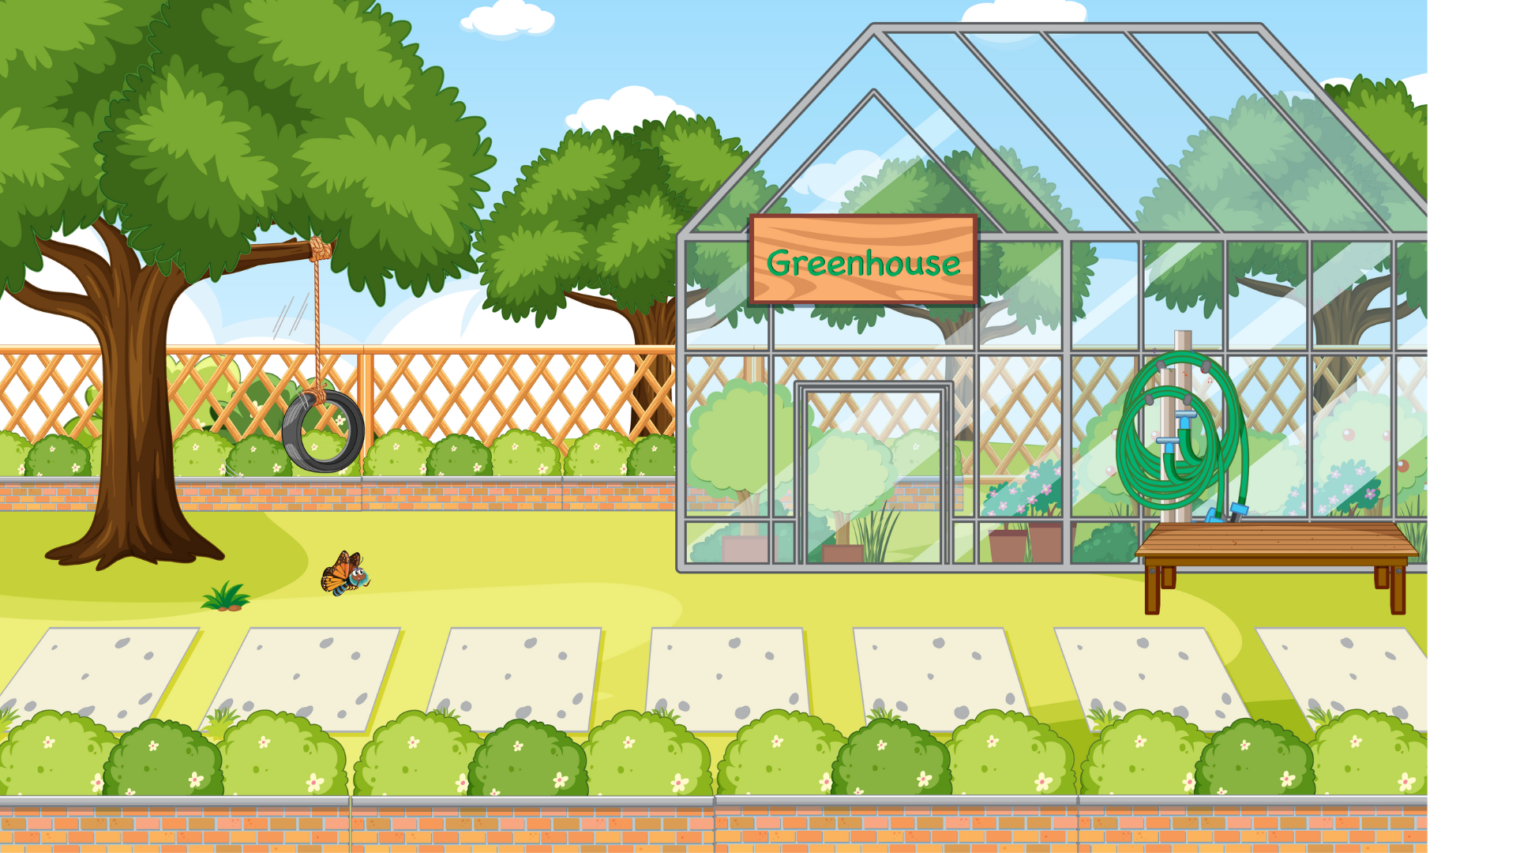
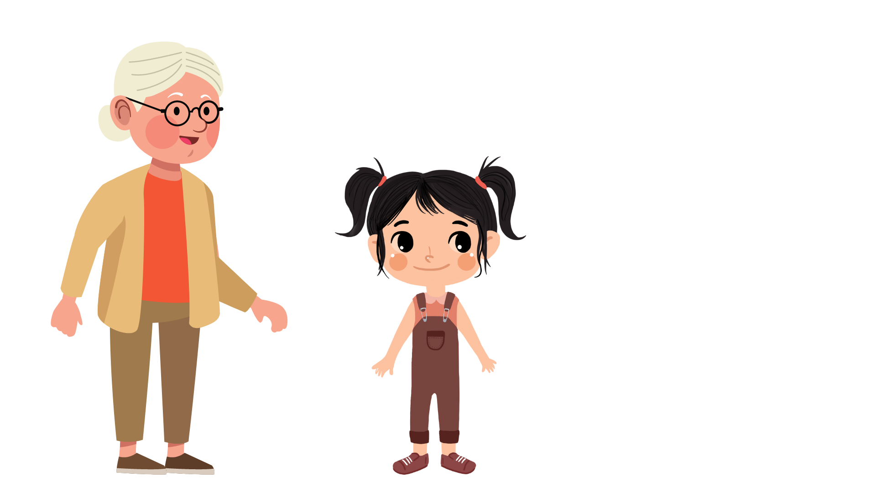
“JEAN AND HER GRANDMOTHER”

Slide 66
One Sunday, Jean visits her grandmother. Jean wanted to help her grandmother this week. She asked her grandmother how she can help. Her grandmother said the grass has many weeds.

Slide 67
She asked Jean to pick the weeds. “Fifteen, sixteen, seventeen…” Jean counted the weeds. Jean worked all week, and she picked there hundred and sixteen weeds!

Slide 68
BACK
Day 5
TEST ME!

Slide 69
Directions:
Read and understand each questions. Then, Click the correct answer.
Are you ready? Let’s begin…

Slide 70
Questions:
Whom did Jean want to help?
mom and dad
grandmother
grandfather

Slide 71
Questions:
Did Jean help her grandmother?
yes
no
maybe

Slide 72
Questions:
How many weeds did Jean pick?
fifteen
three hundred
three hundred and sixteen

Slide 73
Level 03
Vowel pairs ay, ai, ei and ie that make long vowel sound
Day 1
Day 2
Day 3
Day 4
Day 5
RETURN

Slide 74
BACK
Day 1
Let’s PLAY

Slide 75
Directions:
Fill in the blanks. Complete the word by choosing a letter from the list.
Are you ready to play?

Slide 76
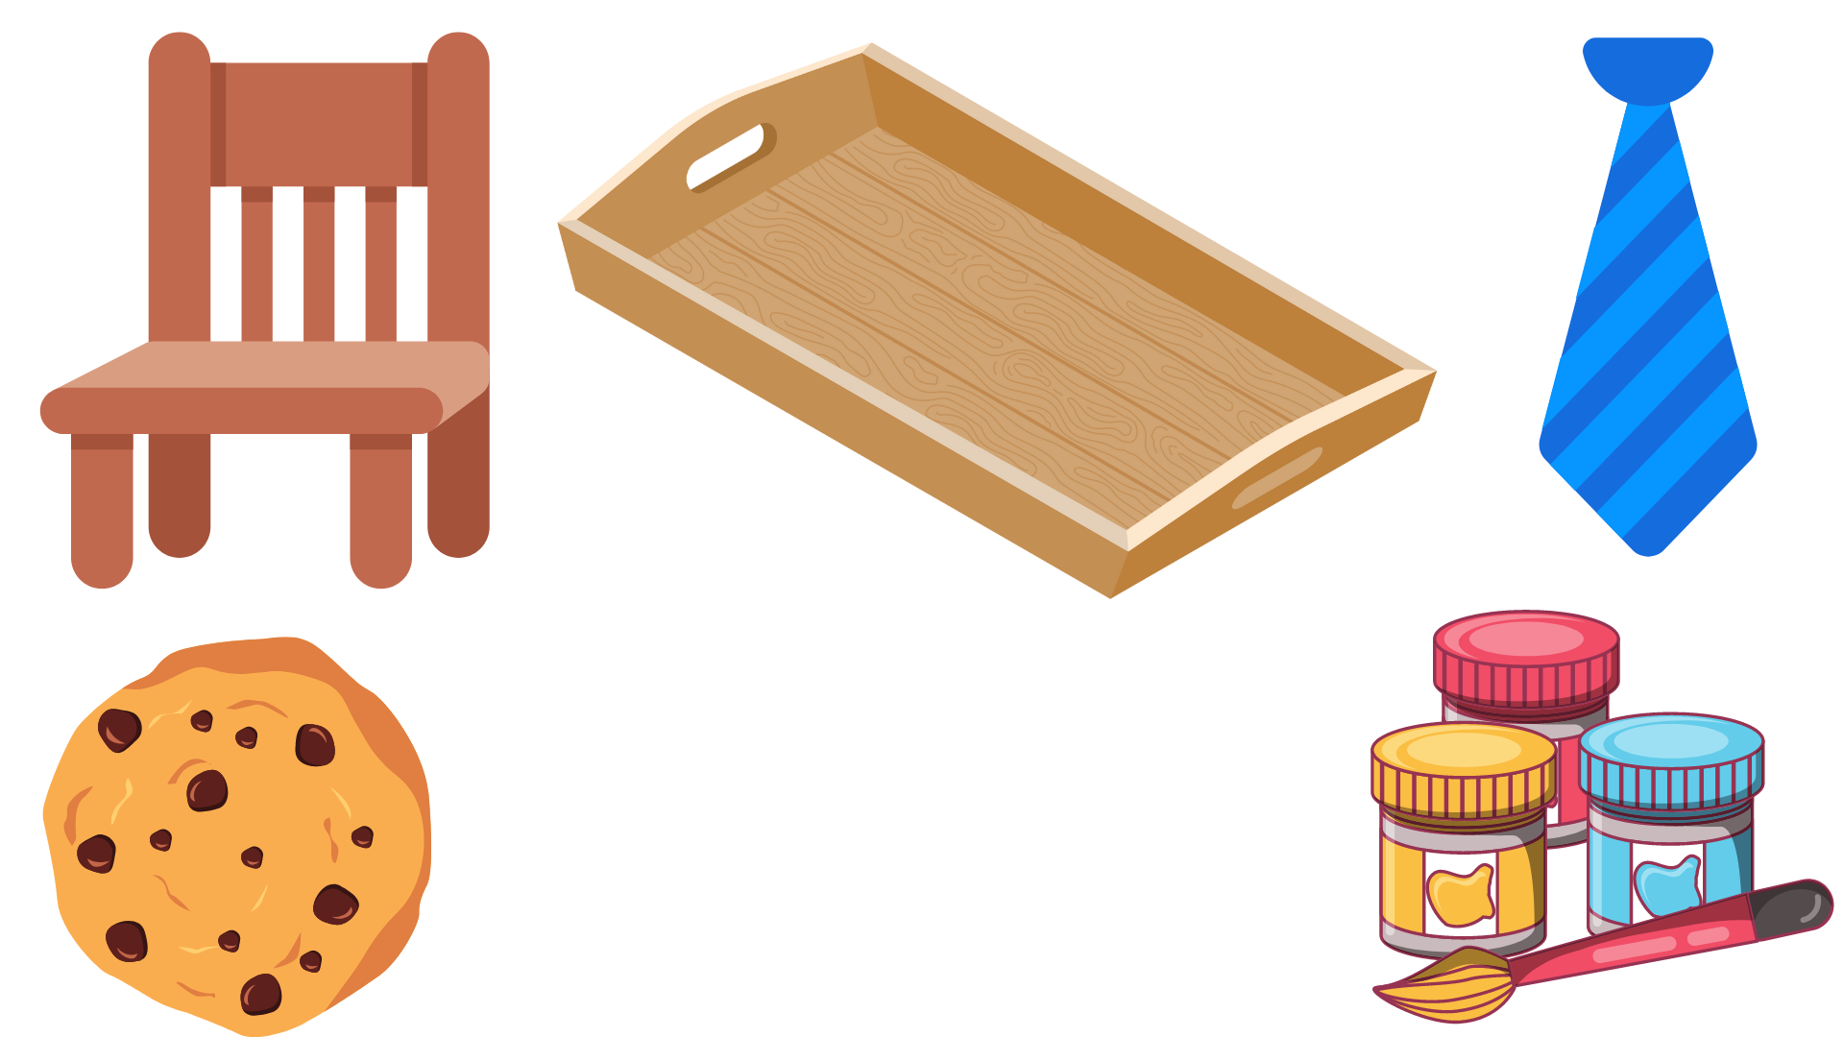
a
e
i
o
u
C
h
i
r

Slide 77
a
e
i
o
u
C
o
o
k
e

Slide 78
a
e
i
o
u
p
a
n
t

Slide 79
a
e
i
o
u
t
i

Slide 80
y
l
c
o
u
t
r
a

Slide 81
BACK
Day 2
Work with Me!

Slide 82


In some words, two vowels together make a long vowel sound.
The vowel pairs ay and ai make the long –a sound.
Example:
way
tail

Slide 83

The vowel pair ei make the long –a sound.
Example:
weight
eight

Slide 84
The vowel pair ie make the long –i sound.
Example:
cookie
tie

Slide 85

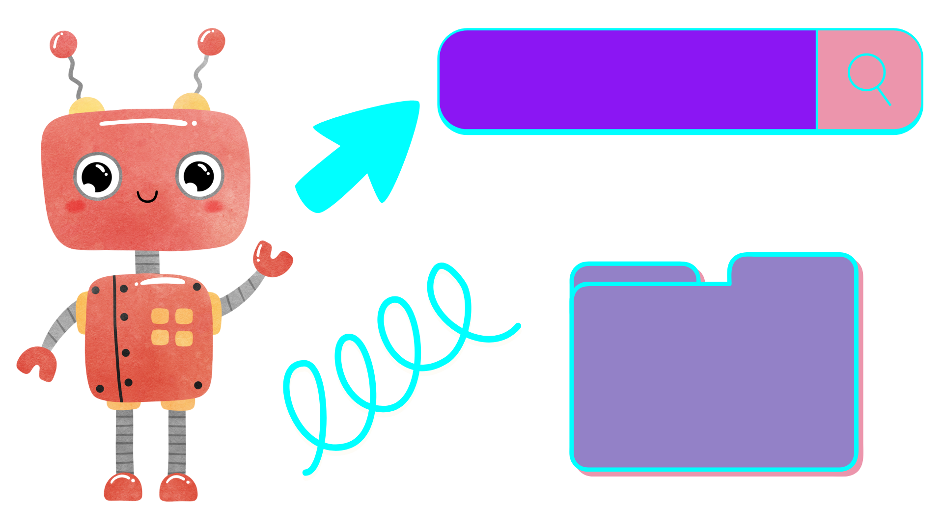
Hello. I want to play with you!
Please, click my button if you’re ready to play with me.

Slide 86
Complete each sentence by choosing a word from the list on the right. Use the pictures as your clue. Hold and put the word in the blanks.

Slide 87
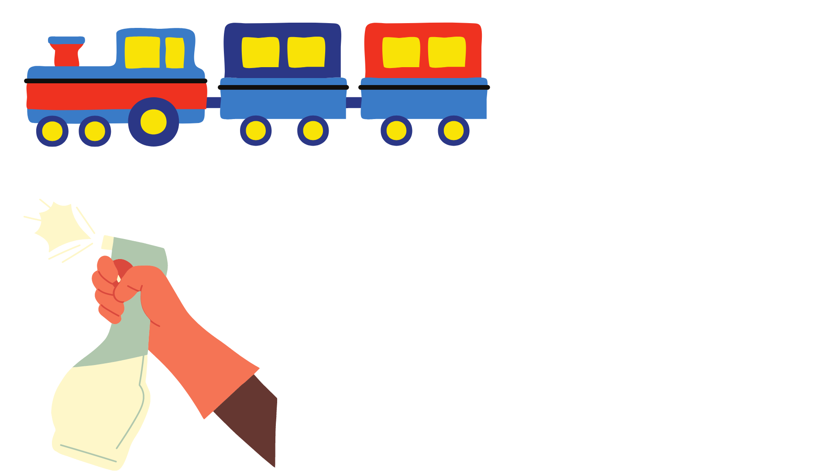
tray
1. We shall wait for the ____.
tail
train

Slide 88
2. Our house needs a new coat of____.
chain
sail
paint

Slide 89
tray
3. The glasses are on a _____.
tail
train

Slide 90
4. What is your_____?
weight
eight
sleigh

Slide 91
5. We will _____ water on the plants.
spray
say
tail

Slide 93
BACK
Day 3
Let’s Practice!

Slide 94
Practice Time!
Click the words with long vowel sound (ay, ai, ei , and ie)
Are you ready?

Slide 95
spray
sat
cat
hay
pay
cup
show
raise
say

Slide 96
pillow
gray
can
may
glow
rain
pail
team
veins

Slide 97
eighty
bellow
stay
sea
chain
road
claim
crab
sail

Slide 99
BACK
Day 4
I’m ready to read a short story!

Slide 100
Hello! Please highlight the words with ay, ai, ei and ie.

Slide 101
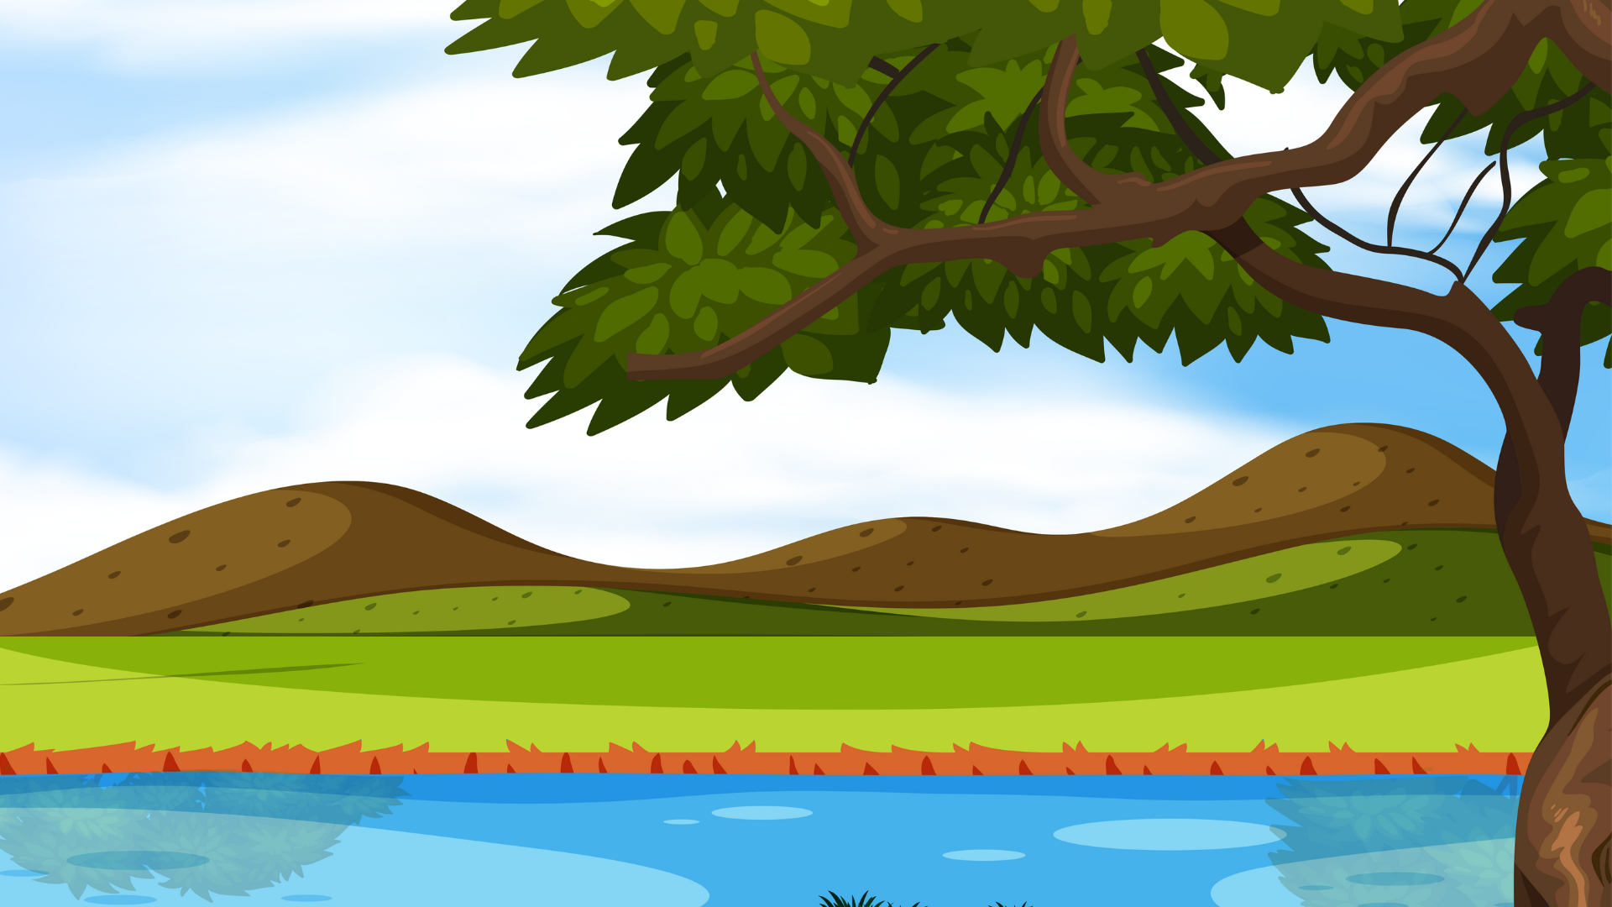
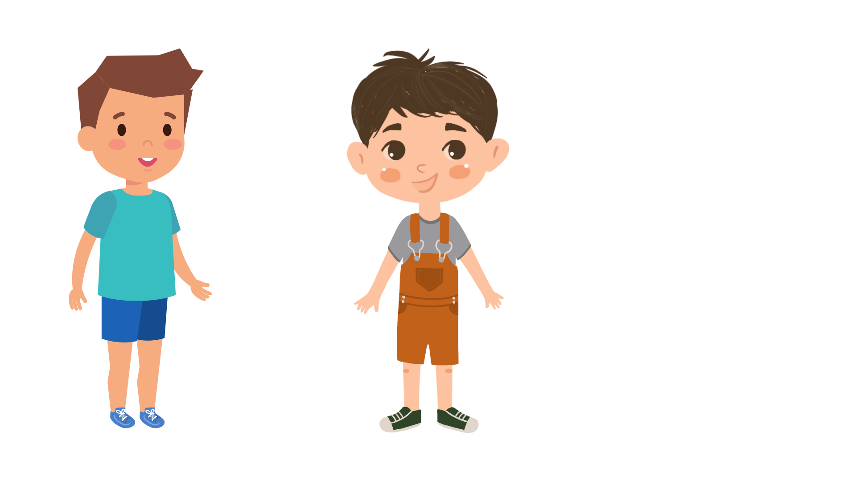
Jay and Ray are classmates. They are good friends. They like to play at the lake.

Slide 102
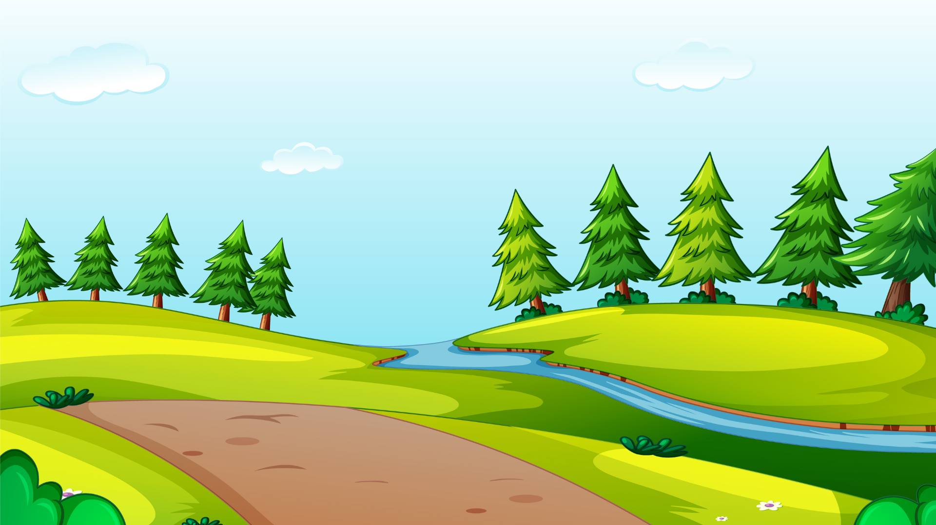
One day, they made a maze in the hay.

Slide 103

On the same day, heavy rain comes,

Slide 104
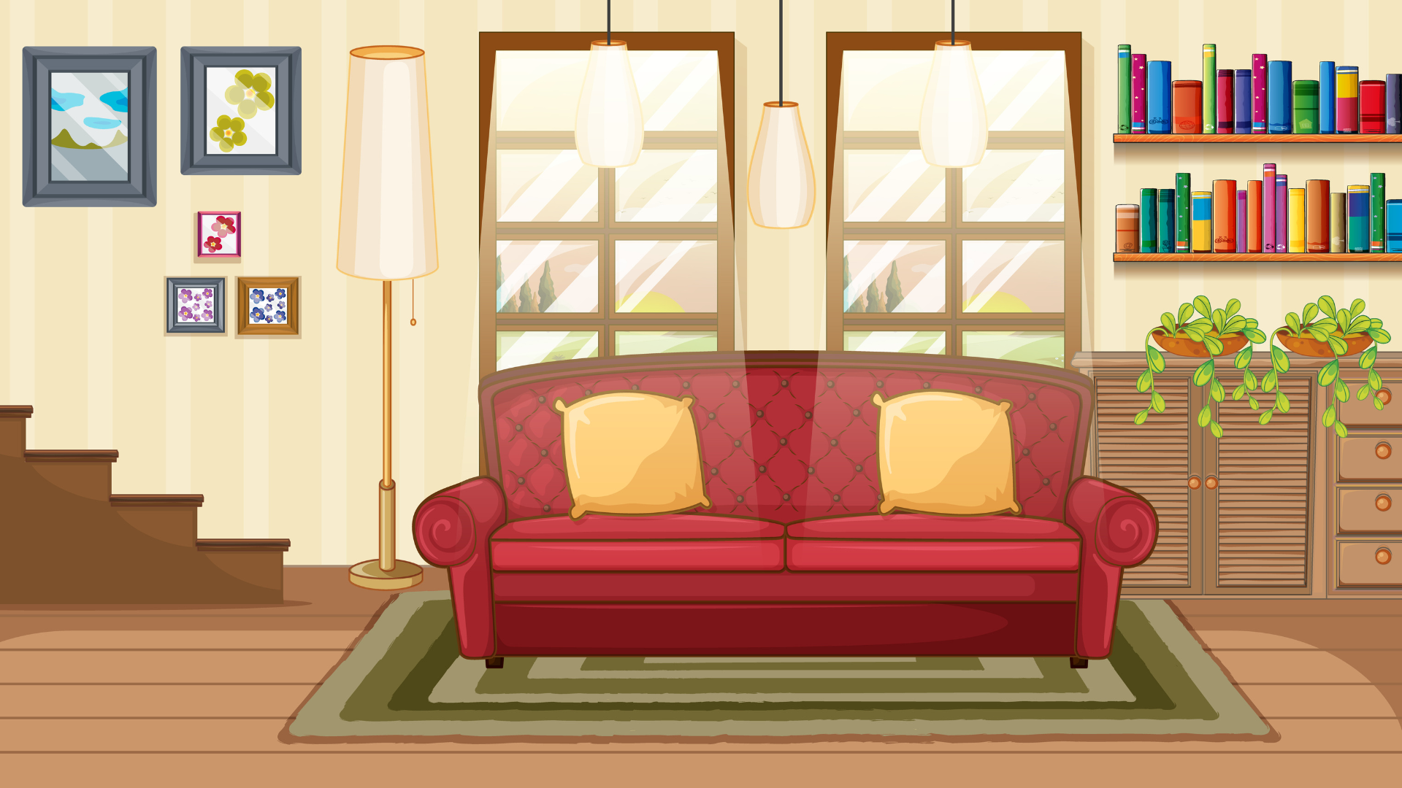
So, Jay and Ray run back to play games.

Slide 105
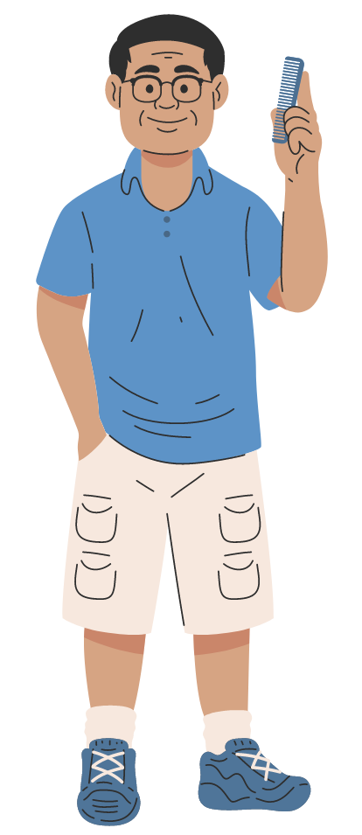
“Can Jay stay and play game?” Ray asked his dad.

Slide 106
“Jay can stay and play if her mom and dad say it is okay,” Ray’s dad say.

Slide 107
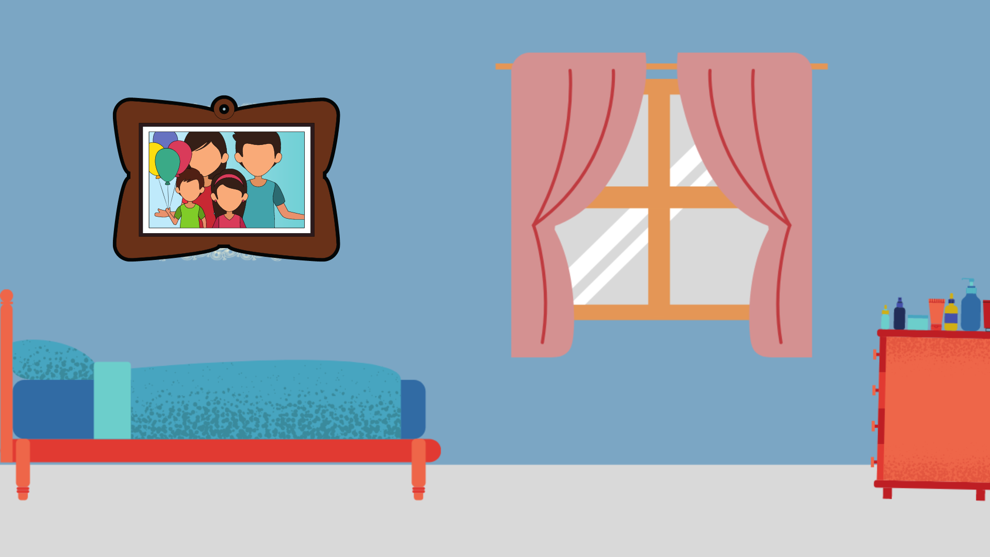
Jay and Ray stayed up late and played games.

Slide 108
BACK
Day 5
TEST ME!

Slide 109
Directions:
Read and understand each questions. Then, Click the correct answer.
Are you ready? Let’s begin…

Slide 110
Questions:
Who are good friends?
Jane and Jean
Jay and Ray
Kay and Fay

Slide 111
Questions:
Jay and Ray like to ____ at the lake.
play
sing
dance

Slide 112
Questions:
They made a maze in the ____.
hay
say
lay

Slide 113
Questions:
What happens the same day they made a maze?
The heavy rain comes.
The sun raise.
Nothing happens.

Slide 114
Questions:
What did Jay and Ray do when the rain comes?
They play under the sun.
They play in the rain.
They run back.

Slide 115
Level 04
The two sounds of Y
Day 1
Day 2
Day 3
Day 4
Day 5
RETURN

Slide 116
BACK
Day 1
Let’s PLAY

Slide 117
Directions:
Look at the picture. Read the words beside it. Then click the word that names the picture.
Are you ready to play?

Slide 118

cry
carry

Slide 119
fry
forty

Slide 120
silly
sky

Slide 121
rainy
sunny

Slide 122
fly
fry

Slide 123
BACK
Day 2
Work with Me!

Slide 124
The letter y in some words stands for the long i sound.
Example:
fly
cry

Slide 125
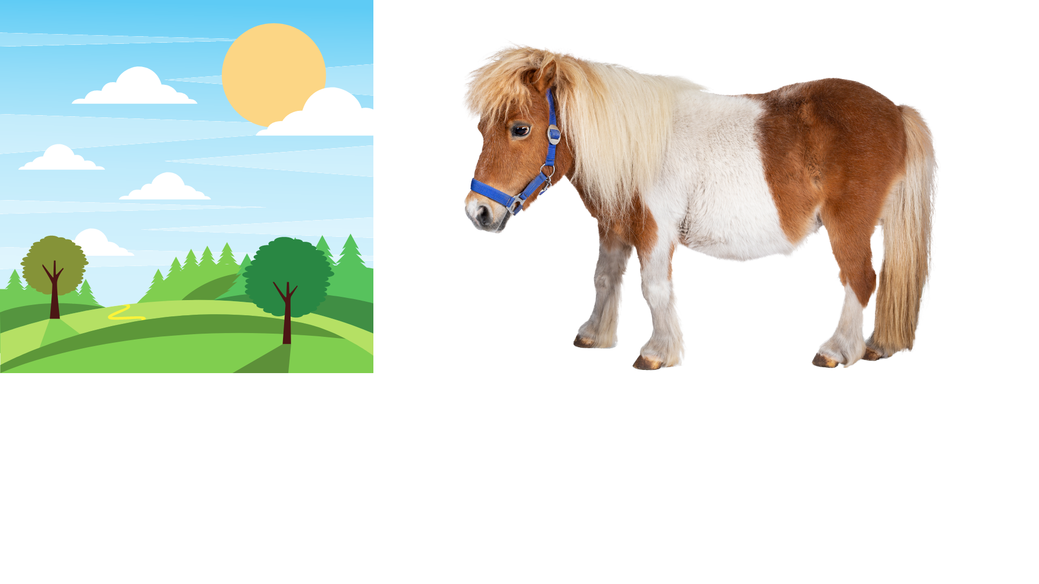
The letter y in some words stands for the long e sound.
Example:
sunny
pony

Slide 126
Hello. I want to play with you!
Please, click my button if you’re ready to play with me.

Slide 127
Say the name of the picture.
Does the letter y make a long i sound?
Does the letter y make a long e sound?
Click the correct answer.

Slide 128
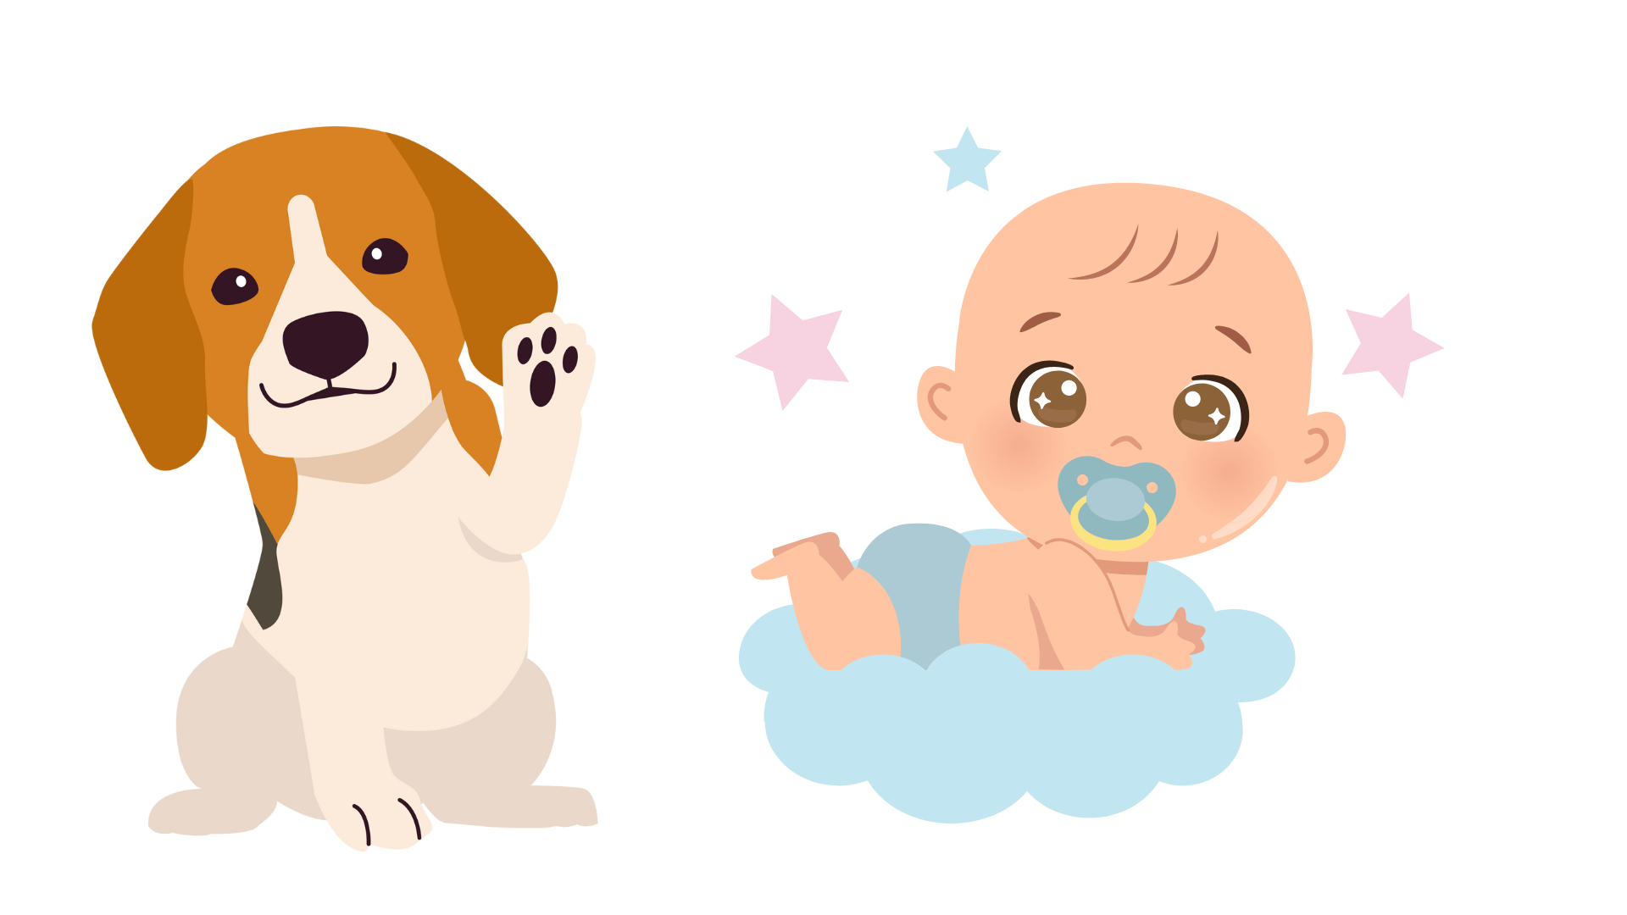
long e
long i
puppy

Slide 129
long e
long i
baby

Slide 130
long e
long i
fly

Slide 131
long e
long i
sky

Slide 132
long e
long i
sunny

Slide 133
BACK
Day 3
Let’s Practice!

Slide 134
Practice Time!
Read each word. Then, click the words with the long i sound and the long e sound.
Are you ready?

Slide 135
cat
rat
cake
cry
spy
jelly
rocky
raise
funny

Slide 136
pencil
pony
dog
happy
glow
fly
baby
book
sunny

Slide 137
puppy
bear
silly
fish
try
fly
mom
cook
dry

Slide 138
BACK
Day 4
Let’s give it a try!

Slide 139
Hello. I want to play with you!
Please, click my button if you’re ready to play with me.

Slide 140
Read each word aloud. If the word ends in a long e sound, as in pony, hold and put the word under the pony. If the word ends in a long i sound, as in fly, hold and put the word under the fly.

Slide 141
long i
long e
cry
penny
tiny
very
try
ruby
by
fry
baby
sky

Slide 142
BACK
Day 5
TEST ME!

Slide 143
Hello. I want to play with you!
Please, click my button if you’re ready to play with me.

Slide 144
Read each word aloud. If the word ends in a long e sound, make a line to connect the word to its corresponding sound. If the word ends in a long i sound, make a line to connect the word to its corresponding sound.

Slide 145
pony
silly
jelly
long e
carry
spy
rocky
long i
snowy
try
dry
daisy

Slide 147
Level 05
Recognizing the R Blends and the S Blends
Day 1
Day 2
Day 3
Day 4
Day 5
RETURN

Slide 148
BACK
Day 1
Recognizing the R Blends
Work with Words

Slide 149
The letter r comes after another consonant.
Blend the sound of the first consonant with the letter r. This is an R blend.

Slide 150
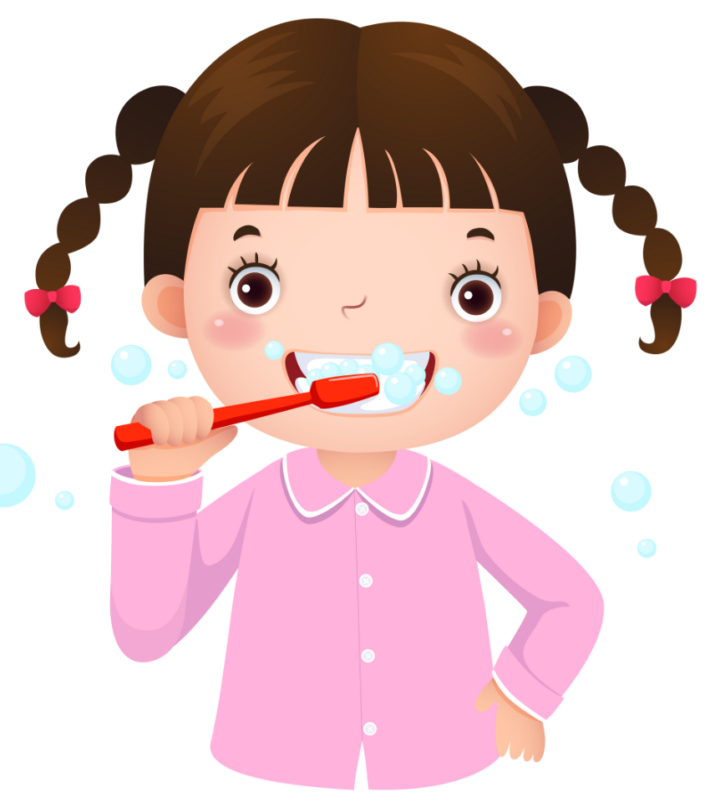
Examples:
The baby is crying.
I brush my teeth every day.

Slide 151
Hello. I want to play with you!
Please, click my button if you’re ready to play with me.

Slide 152
Choose the right r blend to name the picture.

Slide 153
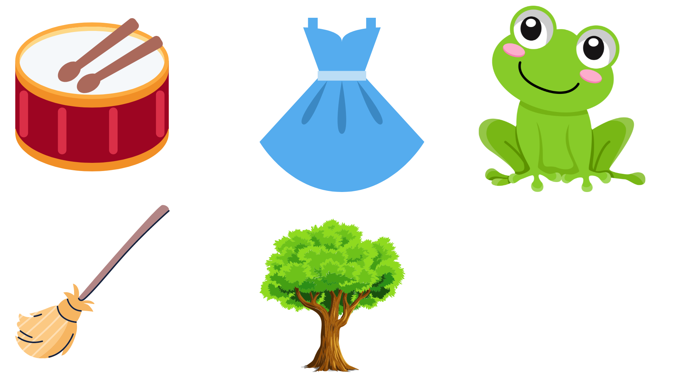
dr
br
___um
___ess
___oom
tr
fr
dr
___og
___ee

Slide 154
BACK
Day 2
Let’s Practice the R Blend!

Slide 155
Practice Time!
Read each word. Then, click the words with “r blend.”
Are you ready?

Slide 156
grass
ribbon
banana
crab
train
crown
flower
raise
crayon

Slide 157
jacket
trap
clock
frame
grapes
truck
rock
crib
funny

Slide 158
brick
lock
bright
sway
grand
sock
broom
pat
dress

Slide 159
BACK
Day 3
Recognizing the S Blends
Work with Words

Slide 160
The letter s comes after another consonant.
Blend the sound of s with the sound of another consonant.

Slide 161
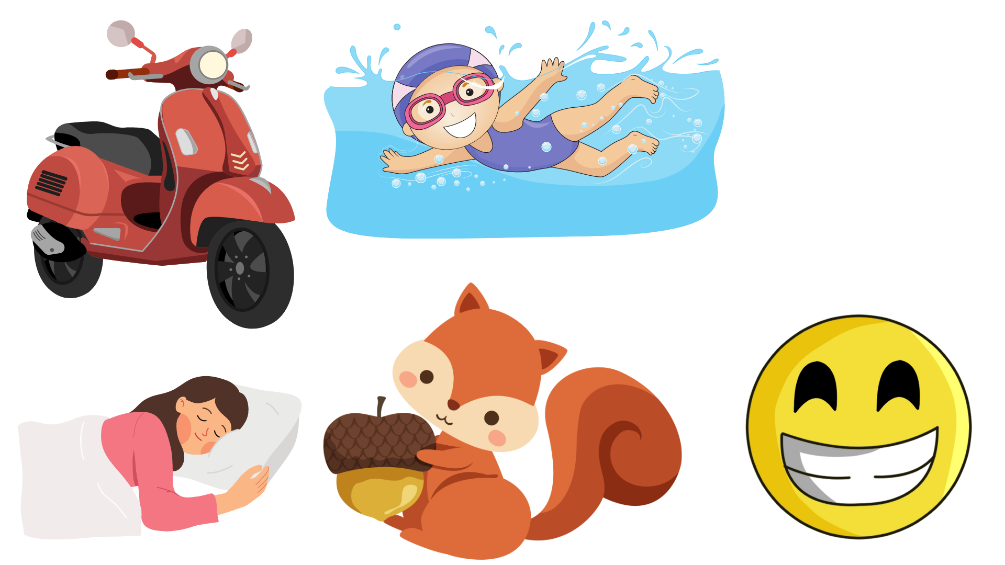
Examples:
scooter
swim
sleep
squirrel
smile

Slide 162
Hello. I want to play with you!
Please, click my button if you’re ready to play with me.

Slide 163
Choose the right s blend to name the picture.

Slide 164
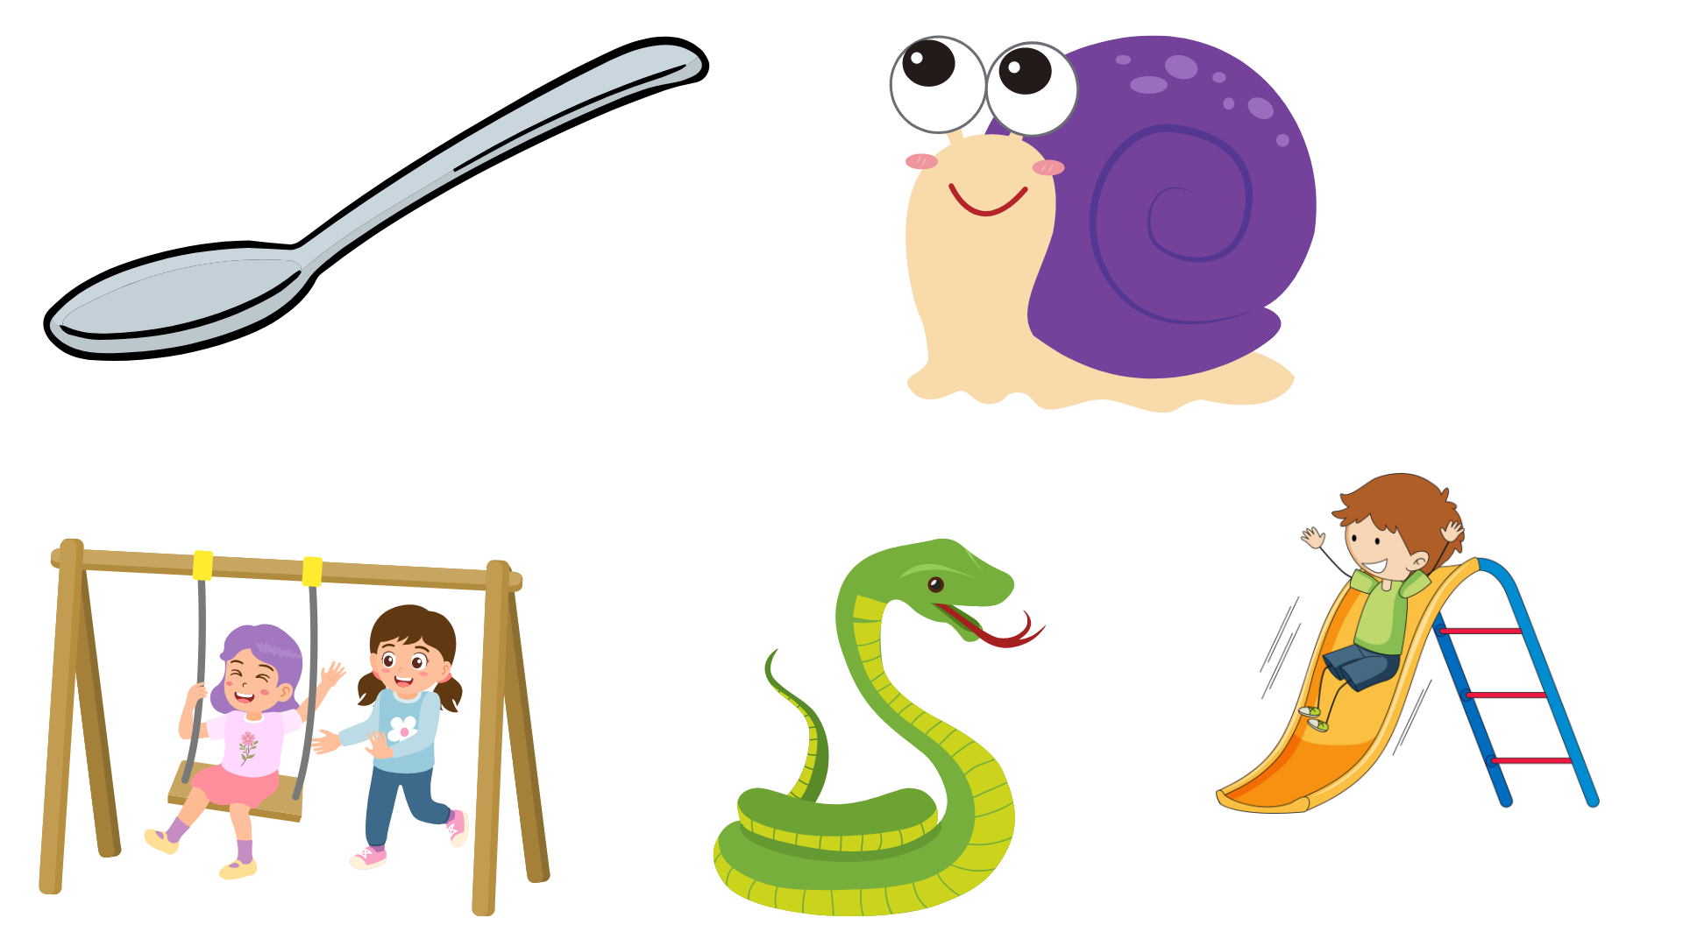
sn
sp
___oon
___ail
___ing
sw
sl
sn
___ake
___ide

Slide 165
BACK
Day 4
Let’s Practice the R Blend!

Slide 166
Practice Time!
Read each word. Then, click the words with “s blend.”
Are you ready?

Slide 167
grass
ribbon
spin
snap
scooper
sleep
flower
store
crayon

Slide 168
snail
trap
snake
swing
grapes
truck
slide
crib
square

Slide 169
brick
lock
slide
sway
stone
stock
skate
pat
dress

Slide 170
BACK
Day 5
TEST ME!

Slide 171
Hello. I want to play with you!
Please, click my button if you’re ready to play with me.

Slide 172
Complete the words with the correct blends and match them.

Slide 173
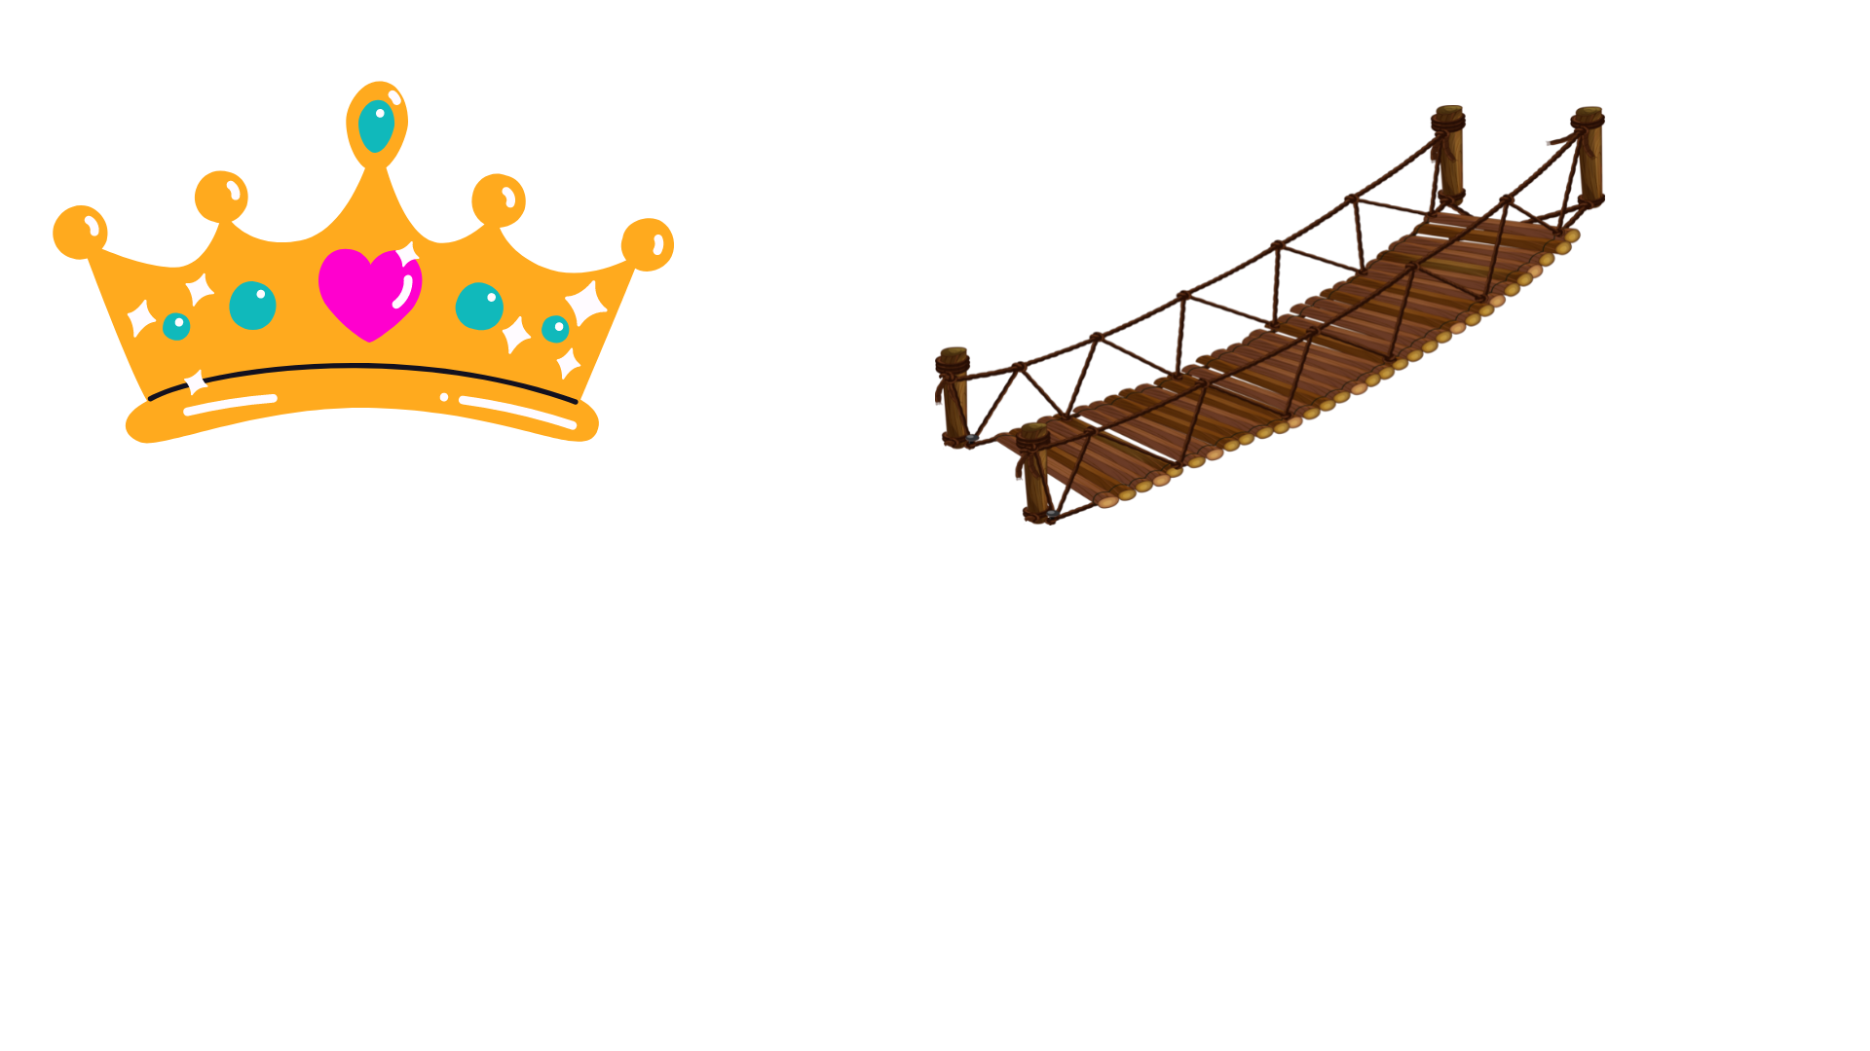
___own
___um
___idge
___oom
___ess

Slide 174
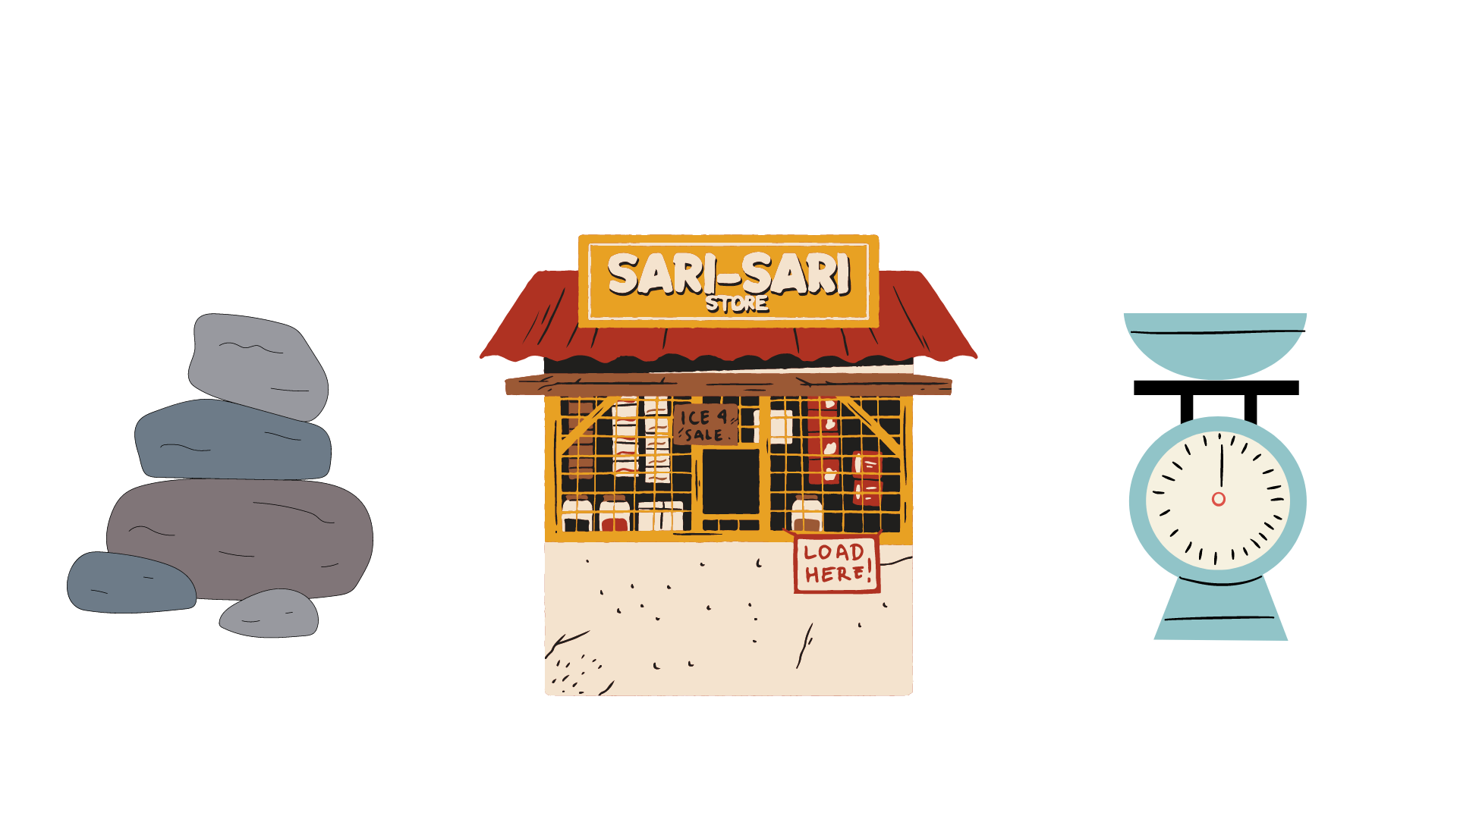
___ail
___uirrel
___ore
___one
___ale

Slide 176
Level 06
Noting Details
Day 1
Day 2
Day 3
Day 4
Day 5
RETURN

Slide 177
BACK
Day 1
“Katrina’s Trip To The Ocean”

Slide 178
Hello. I want to read with you!
Please, click my button if you’re ready to read with me.

Slide 179
Read the passages. Then answer each question.

Slide 180
“Katrina’s Trip To The Ocean”

Slide 181

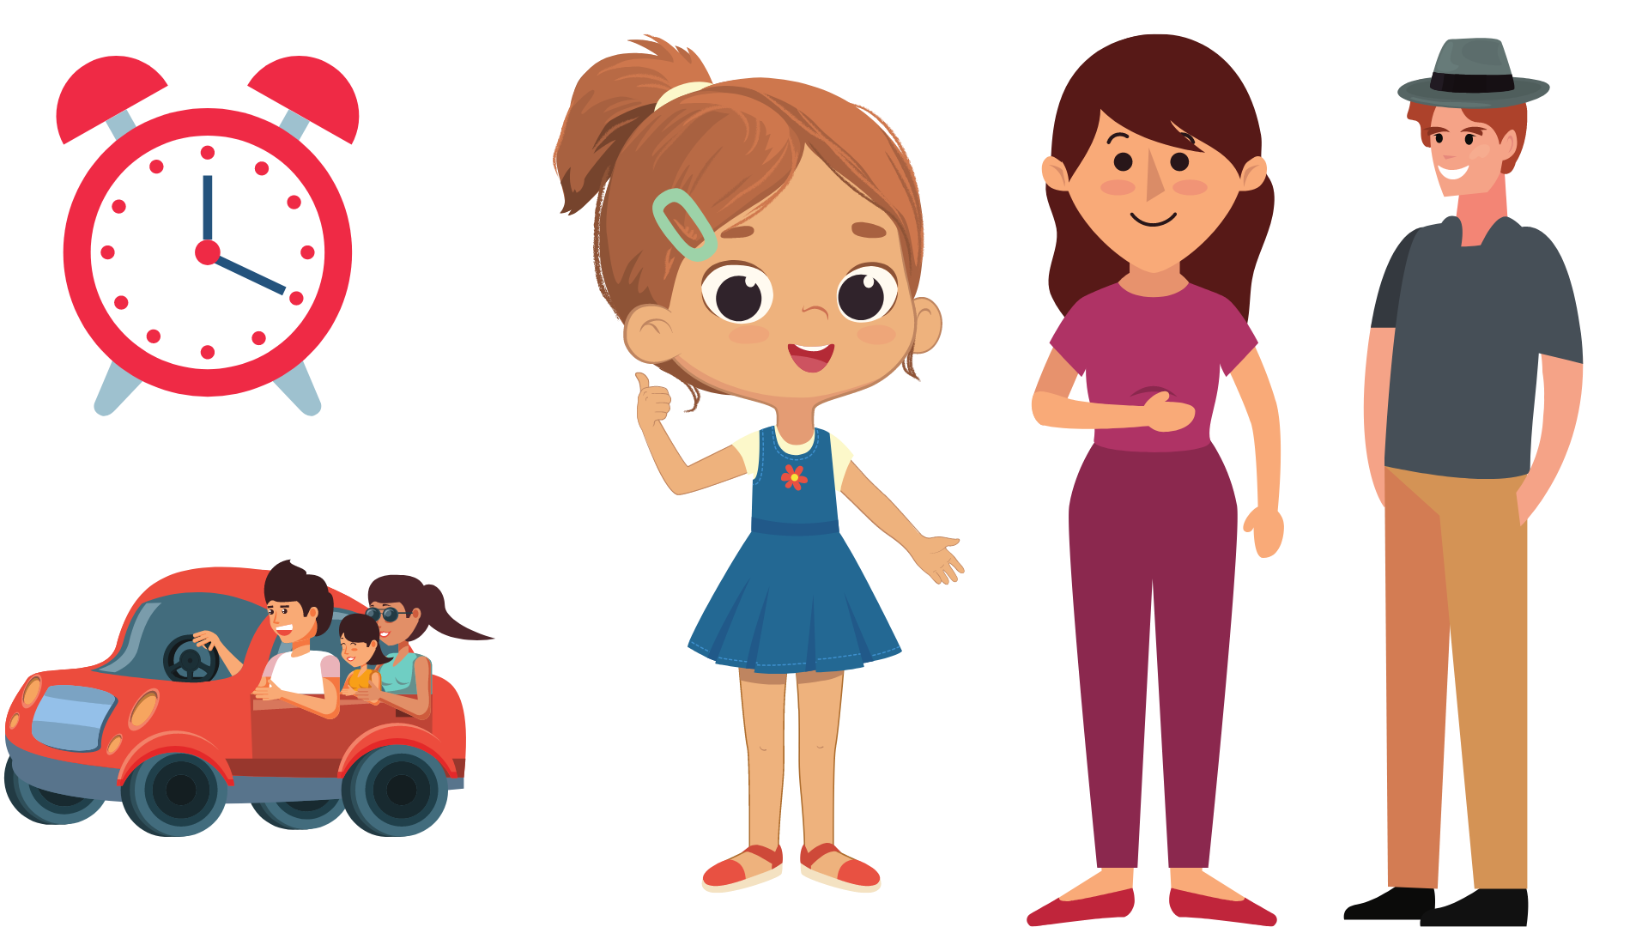
As the alarm clock started with a loud ring, Katrina got out of her bed excitedly. They were going to the beach today and she didn’t want to be late.

Slide 182
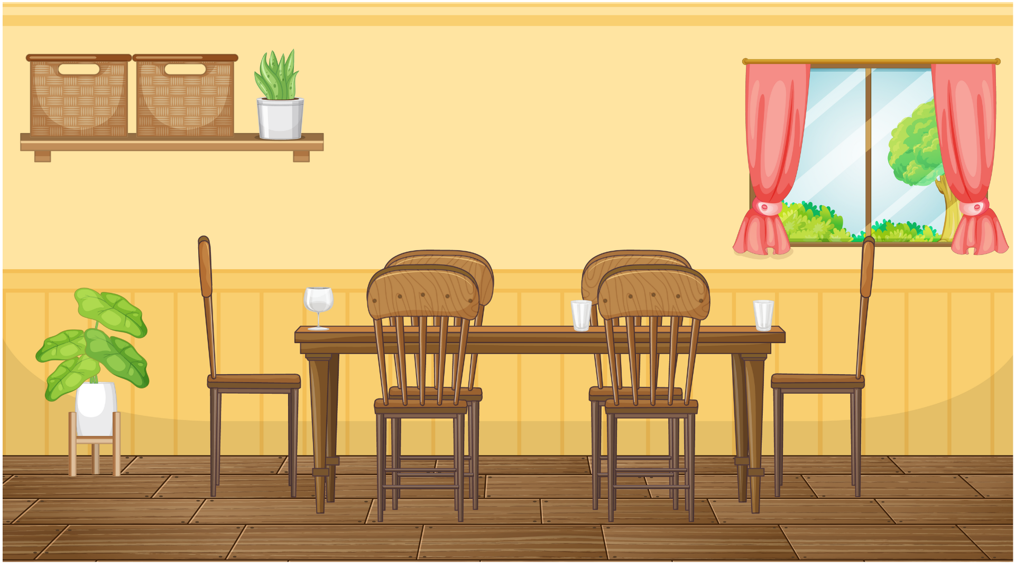
When Katrina went down for breakfast, mother had already prepared a big picnic basket filled with all kinds of food.
“Do you have your things ready?” Mother asked.
“Yes, Mother. I packed my red bathing suit, my yellow pail, and my pink spade.”

Slide 183
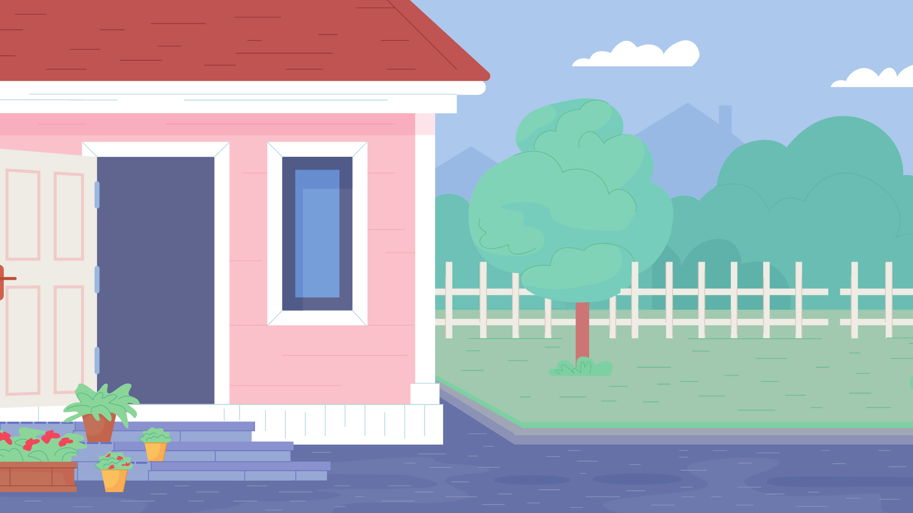
After a hearty breakfast, Katrina and her parents piled into their car and headed for the ocean.

Slide 184
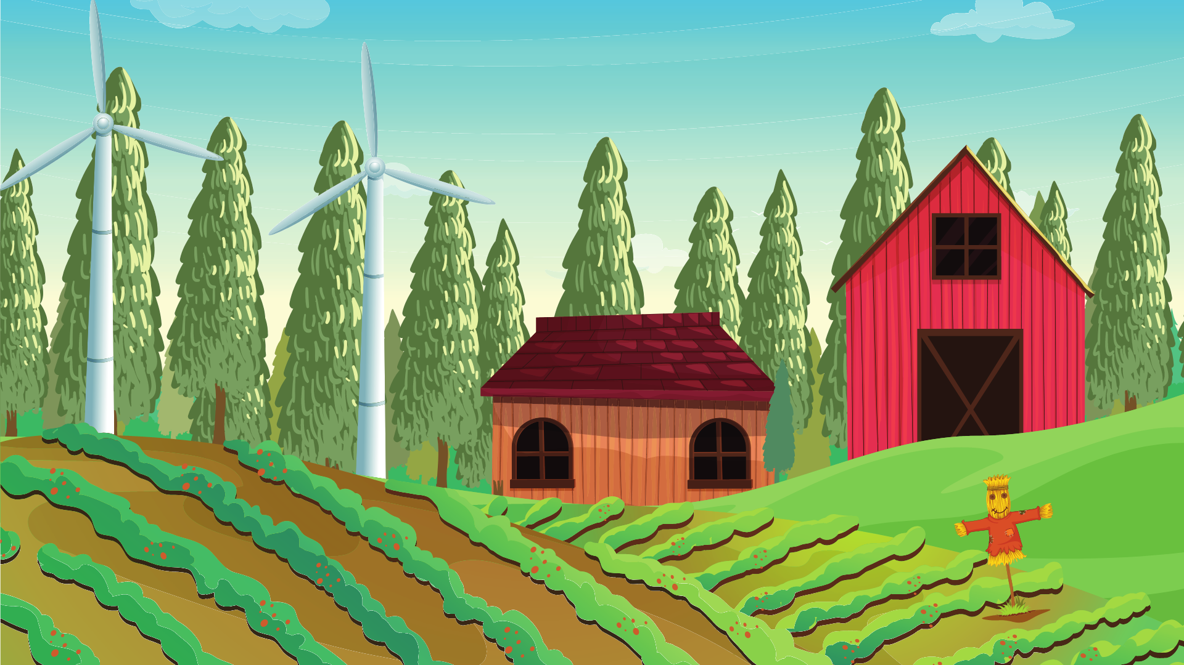
Katrina watched the scenery as they went along. She saw many things. She saw houses, rice fields, and a funny scarecrow. She waved at some children playing by the roadside.

Slide 185

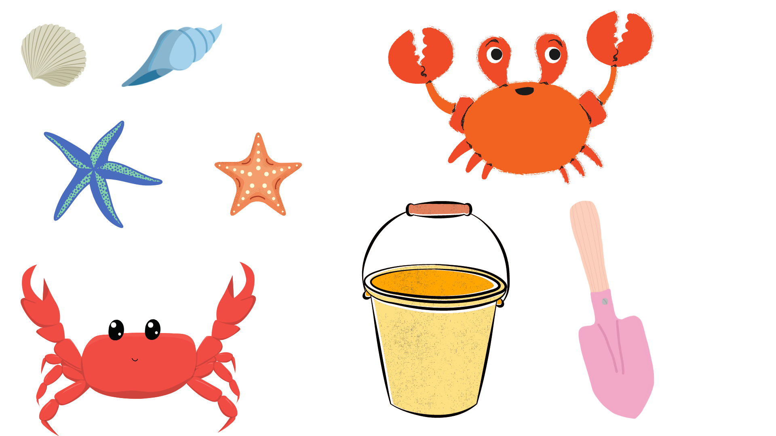

Finally, they reached the beach. Katrina excitedly ran to the water. The golden sand felt soft and warm under her feet. She saw different kinds of shells, even a shell shaped like a fan. She also saw a starfish and a crab digging in the sand.

Slide 186

Katrina swam all day. She also built a beautiful sandcastle with her yellow pail and pink spade.
At the end of the day, when the sky started to grow dark, her family went home.

Slide 187
Directions:
Read and understand each questions. Then, Click the correct answer.
Are you ready? Let’s begin…

Slide 188
Questions:
Who is the main character in the story?
Jane
Katrina
Mother

Slide 189
Questions:
Where did Katrina go?
Beach
Market
School

Slide 190
Questions:
What did she bring?
basket
Paper, pencil, and notebook
red bathing suit, yellow pail, and pink spade

Slide 191
Questions:
What did she see on the way to the ocean?
She saw houses, rice fields, and a funny scarecrow.
She saw a dog.
She saw many trees.

Slide 192
Questions:
What time did Katrina go home?
When the sun started to raise.
When the sky started to grow dark.
Afternoon.

Slide 193
BACK
Day 2
“Going To The Market”

Slide 194
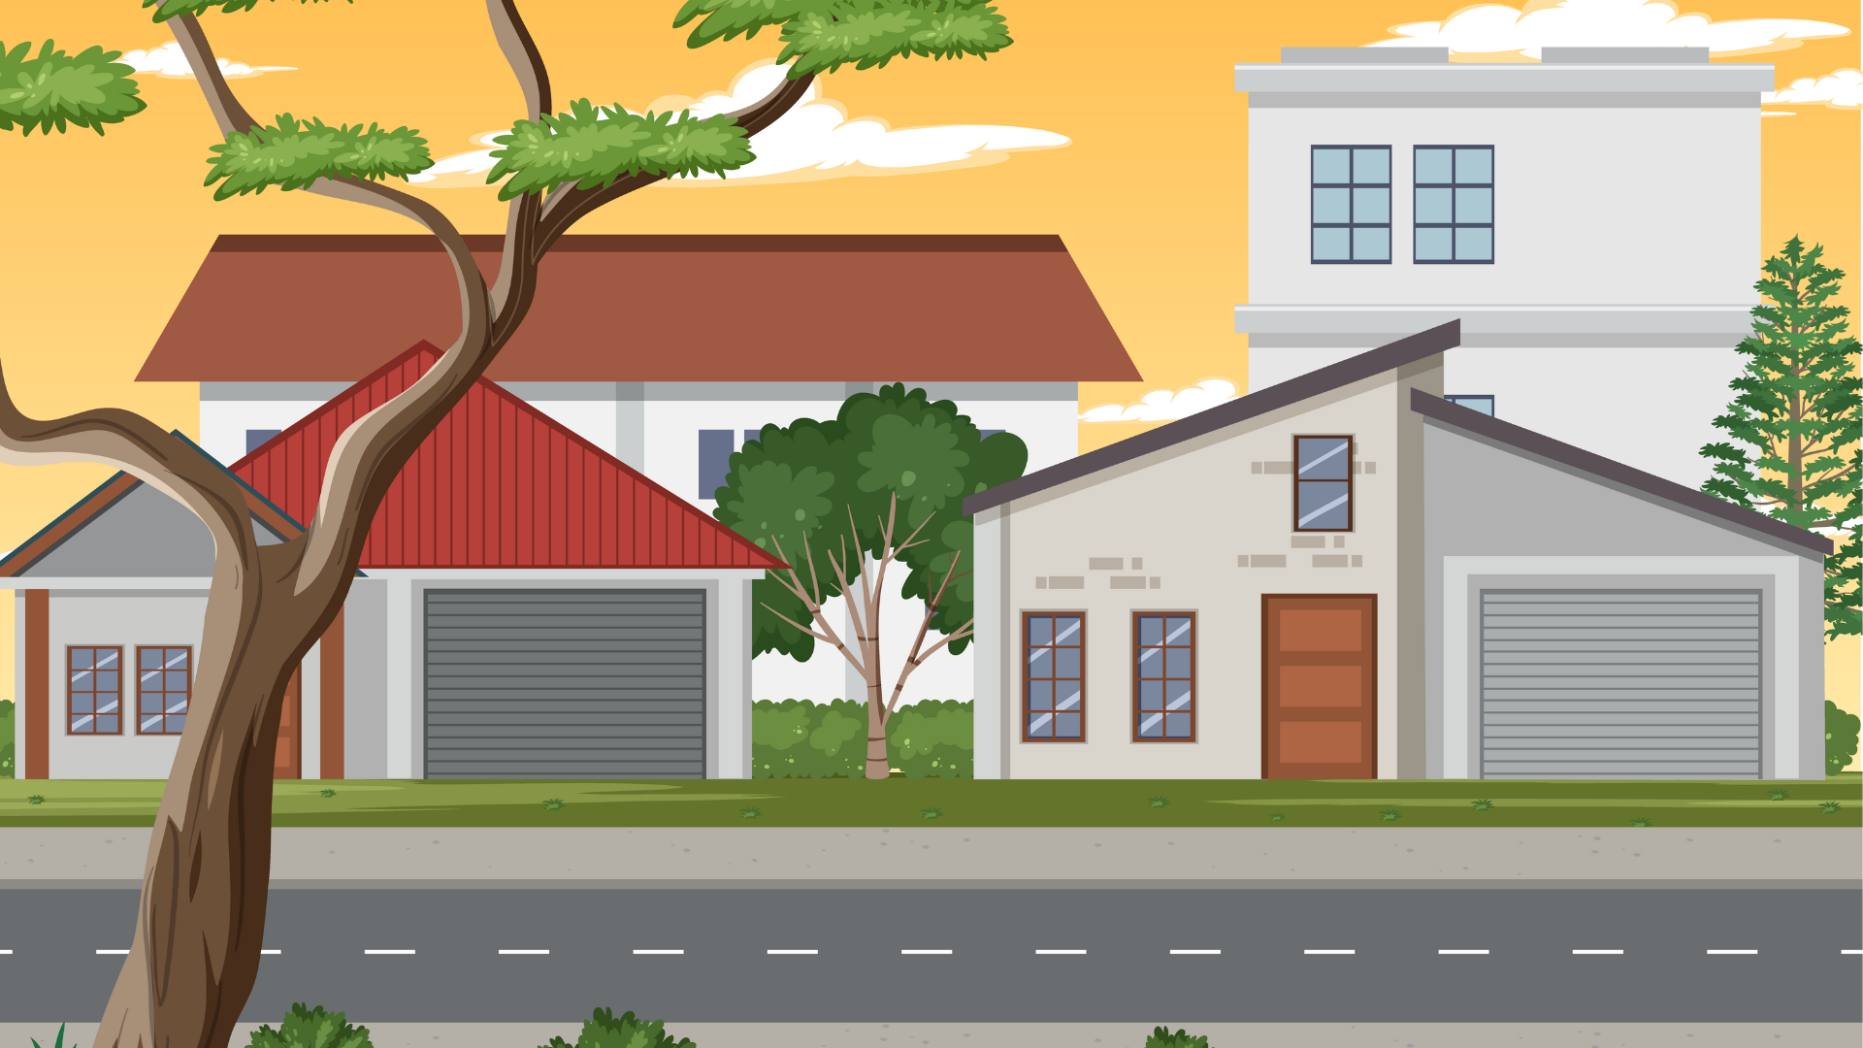
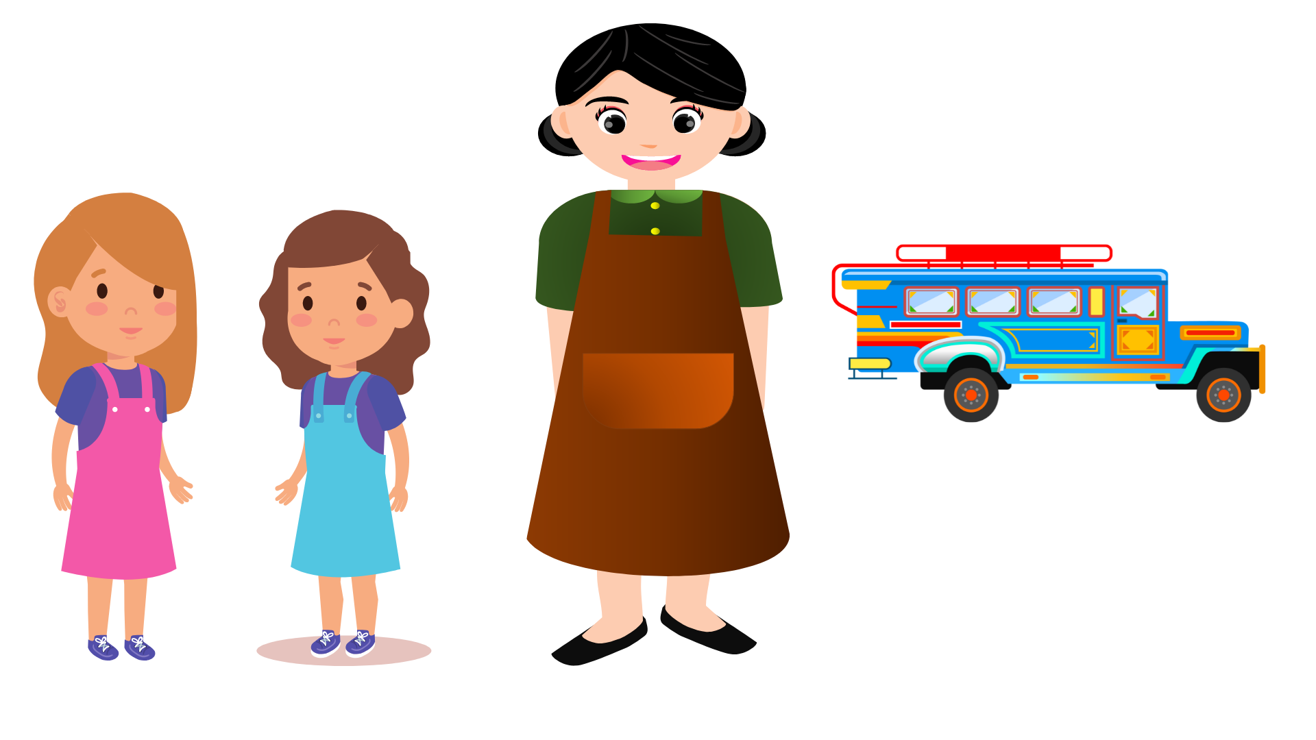
“I am going to the market,” Mother said.
“Can we go too?” asked Tina and Shiela.
“Yes, you may,” mother answered.
Mother, Tina, and Shiela rode the jeepney. Tina saw a girl selling plastic bags as they entered the market. Mother bought meat from the meat shop.

Slide 195
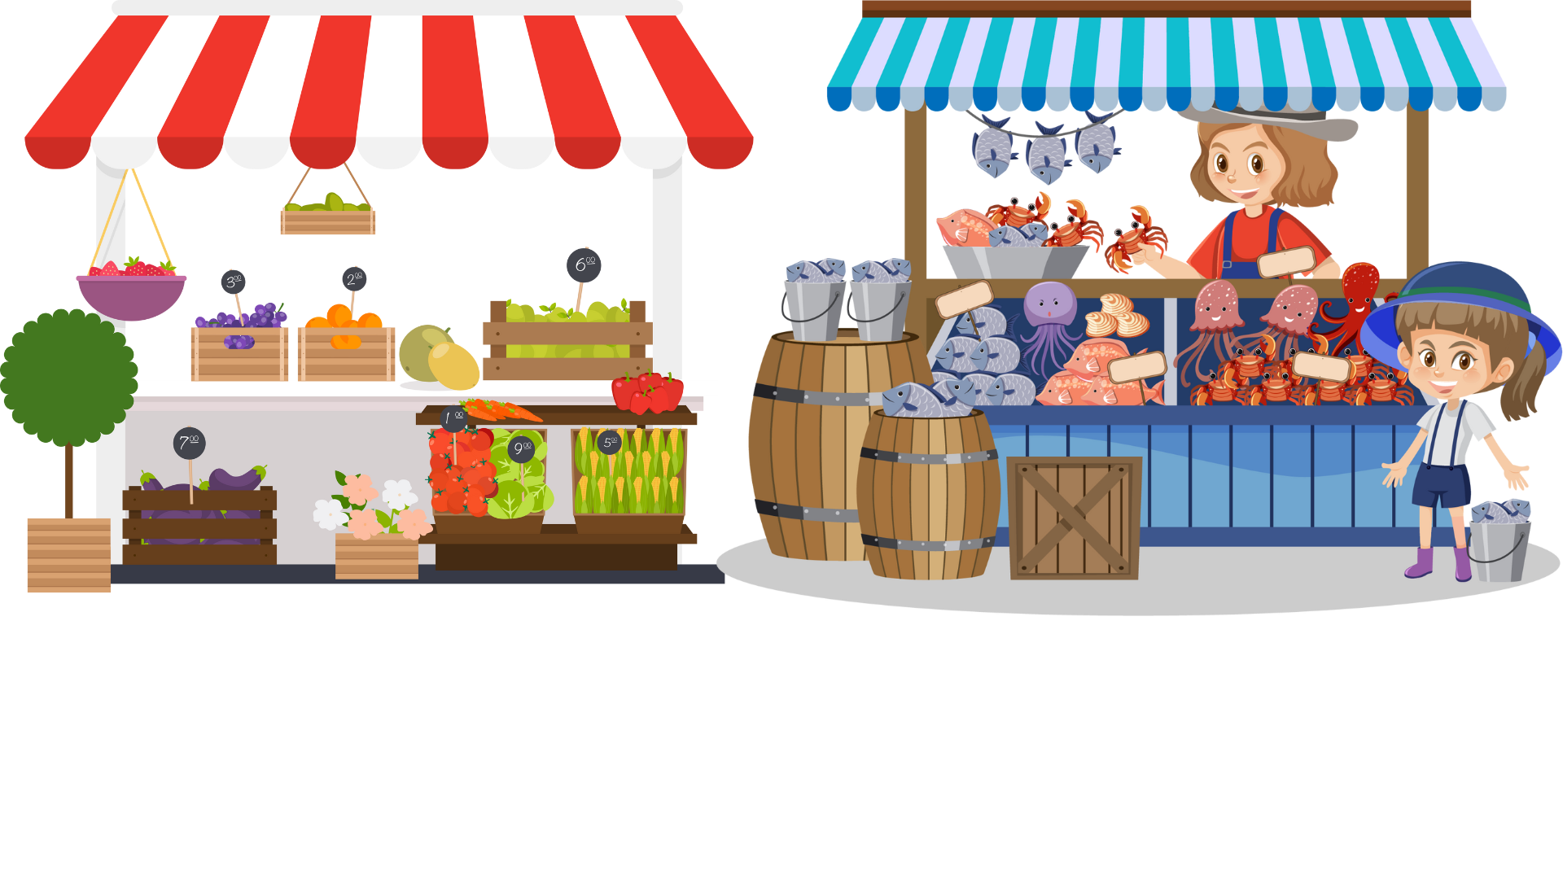
Shiela saw all kinds of fish at the fish stall. There were bangus, dalagang bukid, tilapia, and others.
“Mother, let’s buy some watermelon,” Tina said. So, they went to the fruit stand and bought fruits. “Oh! I almost forgot to buy vegetables,” mother said. The two girls and their mother went to the vegetable section. Sheila said, “Mother I’m tired. “Can we rest now?” Mother took them to an eatery and bought halo-halo. They all enjoyed the halo-halo.

Slide 196
Directions:
Read and understand each questions. Then, Click the correct answer.
Are you ready? Let’s begin…

Slide 197
Questions:
Who are the characters in the story?
Tina, Shiela, and Mother
Katrina
Mother

Slide 198
Questions:
Where did the story happen?
Store
School
Market

Slide 199
Questions:
What did Shiela see at the fish stall?
Lapu-lapu and Tulingan
Salmon, Crab, and Shrimp
Bangus, Dalagang bukid and Tilapia

Slide 200
Questions:
Where did mother, Tina, and Shiela go after the fish stall?
They went to an eatery and bought halo-halo.
They went to the vegetable section and bought carrots.
They went to the fruit stand and bought fruits.

Slide 201
Questions:
After the vegetable section, where did they go?
They went to an eatery and bought halo-halo.
They went to the vegetable section and bought carrots.
They went to the fruit stand and bought fruits.

Slide 202
BACK
Day 3
“The Buzzing Mosquito”

Slide 203
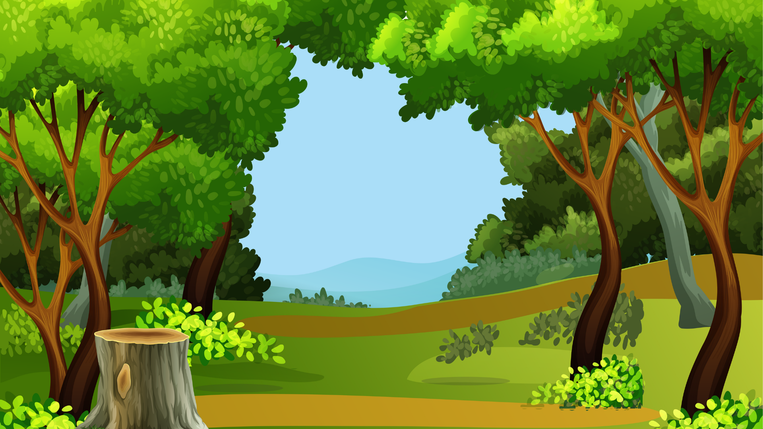
Once there was a cruel king. He was king crab. All small insects and creatures are under him.
When he was asleep, he wanted everybody to keep quiet.
One day, when he was asleep, frogs croaked and laughed very loudly.
The king was awakened. He called for the biggest frog.

Slide 204
“Why were you laughing so loudly?” he asked.
“We were laughing because we saw the turtle carrying his house on his back,” answered the frog.
The king called for the turtle.
“Why do you carry your house on your back?” he asked.
“I carry it on my back because I’m afraid the firefly might burn it,” the turtle replied.

Slide 205
“Why do you carry fire with you?” the king asked the firefly.
“To protect me from the mosquito who likes to bite me.”
The king asked the mosquito why he likes to bite the firefly. The mosquito did not answer but flew straight to the king and stung him. The king got angry and killed the mosquito.

Slide 206
When the other mosquito heard what happened, they started looking for the king. King crab hid in a hole in the ground.
Do you hear mosquitoes buzzing near your ears? That is because they are still looking for the king Crab in every hole they see.

Slide 207
Directions:
Read and understand each questions. Then, Click the correct answer.
Are you ready? Let’s begin…

Slide 208
Questions:
Who are the main characters in the story?
King Crab and Mosquito
frog
firefly

Slide 209
Questions:
What happened while King Crab was asleep ?
The frogs croaked and laughed very loudly.
The small creatures and insects play with each other.
The small creatures and insects argued.

Slide 210
Questions:
Who did King Crab call after he talked to the frog?
Biggest frog
Turtle
Firefly

Slide 211
Questions:
Why did King Crab call for turtle?
Because of his kind heart.
Because of his laziness.
Because the turtle carried his house on his back.

Slide 212
Questions:
Where did King Crab hide when he heard that the other mosquitoes were looking for him?
In the hole
In the tree
In the house

Slide 213
BACK
Day 4
“Let us Plant Trees”

Slide 214

Trees are our friends. They give us shade. They protect us from the rain and sun.
Many trees give us fruits to eat. Some of them are mango, santol, and durian. Others are caimito, mabolo, and chico.
Still, others are duhat, orange, pomelo, and lanzones. These fruits are delicious. They make us healthy and strong too.

Slide 215
Some trees have flowers. They come in many colors – red, white, violet, and yellow. All of these are pretty colors. They beautify our surroundings.
Trees give us food. Wood can make into chairs, tables, desks, and cabinets. Wood is all around us. We find it at home, in school, on the playground, and in the church.
Let us plant trees. Trees give us many things.

Slide 216
Directions:
Read and understand each questions. Then, Click the correct answer.
Are you ready? Let’s begin…

Slide 217
Questions:
What is the selection about?
Trees
Woods
Flower

Slide 218
Questions:
Why do we say that trees are our friends?
Because trees are friendly.
Because trees give us food.
Because they give us shade, they protect us from the rain and sun.

Slide 219
Questions:
What different things do trees give us?
Fruits to eat, flowers to beautify our surroundings, and woods.
Mango, santol and caimito
Chairs, tables, and desks

Slide 220
Questions:
In what ways do trees make us healthy and strong?
By giving us flowers to beautify our surroundings.
By giving us fruits to eat.
By protecting us from rain and sun.

Slide 221
Questions:
How do trees beautify our surroundings?
By giving us flowers.
By giving us fruits.
By protecting us from rain and sun.

Slide 222
BACK
Day 5
“The Lucky Anansi”

Slide 223
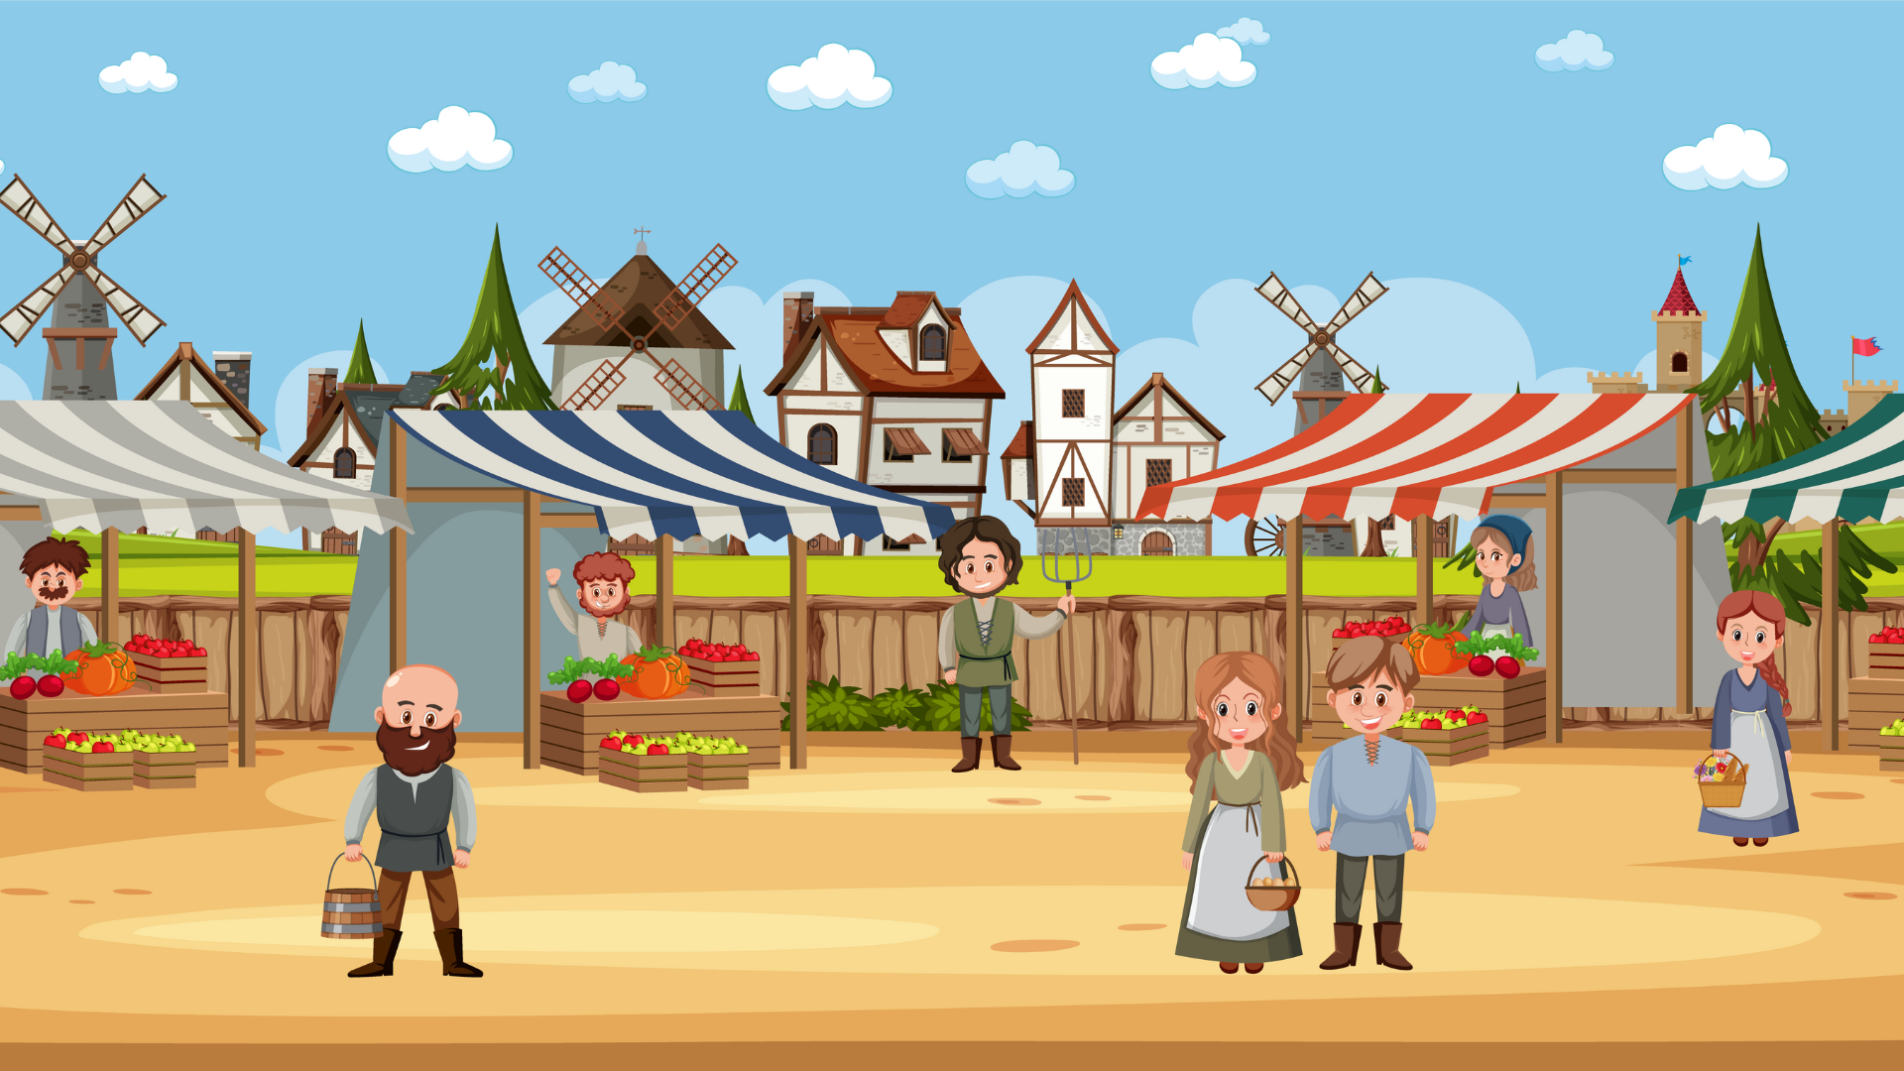
It was a market day.
The animals were busy.
They took their products to the market.
They had something to sell.
They worked and planted in the farm.
Moos-Moos the goat had something to sell.
Kisander the cat had something to sell.
Tiger and Cow had something to sell.

Slide 224
The animals went to the market.
They had something to sell.
Then, they would have money.
They could buy the things they need.
Anansi sat by the door of his hut.
He would not go to the market.
He had nothing to sell.
He did not plant anything.

Slide 225
He could not buy anything.
He had no money.
There was no food in the house.
His family had nothing to eat.
He must do something.
Anansi bowed his head and walked.
He walked and walked and walked.
“Hey! Look where you are going.
You are going to bump me,” said Rat.

Slide 226
Anansi looked up and saw a bunch of big bananas.
“Friend Rat, spare some bananas for my family. We had nothing to eat.
“Didn’t you sell something in the market today?”
“I had nothing to sell. I did not plant anything.”
Rat gave Anansi four bananas.
“Friend Rat, we are five in the family. My wife, Crooky, three children, and myself.”
Rat shook his head.
“One who plants nothing eats nothing.”

Slide 227
At the dinner table, the children looked at Anansi.
“You didn’t have a banana, father?” they said.
Three hands reached into Anansi’s plate.
Each hand gave a half banana.
Crooky looked at Anansi.
“You have more than anyone of us!”
Anansi said to himself,
“One who plants nothing can have something.”

Slide 228
Directions:
Read and understand each questions. Then, Click the correct answer.
Are you ready? Let’s begin…

Slide 229
Questions:
What is the title of the story?
The Lucky Anansi
The Animals
The one who plants

Slide 230
Questions:
Where did the story happen?
In the school
In the park
In the market

Slide 231
Questions:
Who is the main character in the story?
Rat
Anansi
Tiger and Cow

Slide 232
Questions:
How many children does Anansi have?
One
Two
Three

Slide 233
Questions:
Why did Rat give only four bananas to Anansi?
Because he does not like bananas.
Because he was lazy to plant.
Because he was never hungry.

